Slide 1
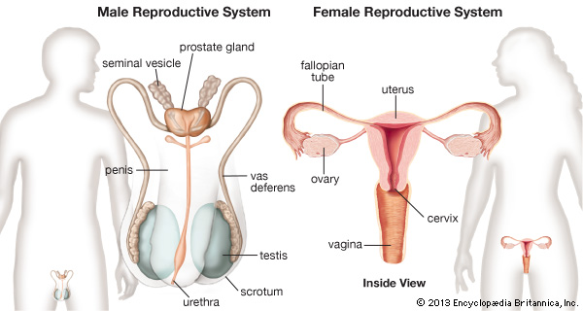
Reproductive System

Slide 2
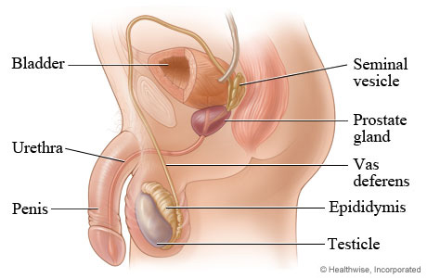
Male reproductive system

Slide 3
The parts:
1. Testis
There are 2 and they lay outside the abdominal cavity, within the scrotum
They descend out of the body during the last two months of fetal development.
The body temperature is lower in the scrotum to allow for viable sperm production
The testis is made of sections called lobules, each of which contains 1-3 tightly coiled seminiferous tubules (sperm is made here)
Video-pathway of sperm
Notes:
The parts:
1. Testis
There are 2 and they lay outside the abdominal cavity, within the scrotum
They descend out of the body during the last two months of fetal development.
The body temperature is lower in the scrotum to allow for viable sperm production
The testis is made of sections called lobules, each of which contains 1-3 tightly coiled seminiferous tubules (sperm is made here)
Video-pathway of sperm

Slide 4
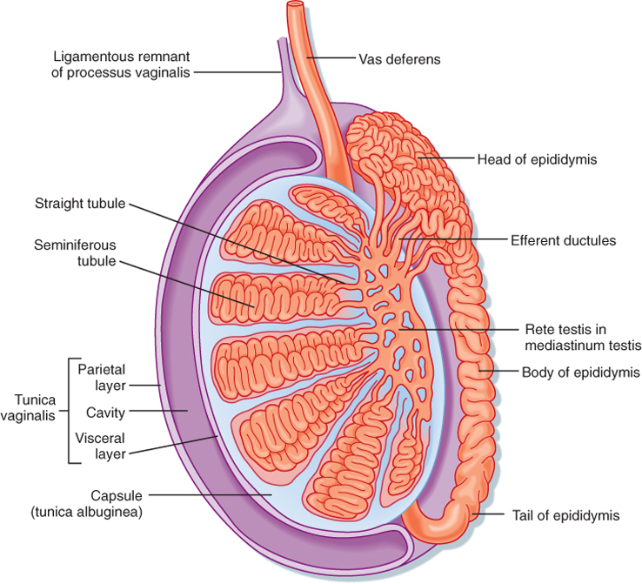

Slide 5
The production of sperm is called spermatogenesis
undifferentiated cells
Undifferentiated cells spermatogonia
primary spermatocytes (46)
Secondary spermatocytes (23) secondary spermatocytes (23)
2 Spermatids (23) 2 spermatids (23)
2 Spermatozoa (23) 2 spermatozoa (23)
Notes:
The production of sperm is called spermatogenesis
undifferentiated cells
Undifferentiated cells spermatogonia
primary spermatocytes (46)
Secondary spermatocytes (23) secondary spermatocytes (23)
2 Spermatids (23) 2 spermatids (23)
2 Spermatozoa (23) 2 spermatozoa (23)

Slide 6
Sperm
head
tail
middle piece
acrosome

Slide 7
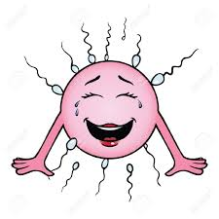
1. Tail: flagella for movement (9+2 pattern of microtubules)
2. Head: contains the nucleus which has the chromosomes (DNA)
3. Middle Piece: has mitochondria for producing energy for the flagella.
4. Acrosome: has enzymes that are used for penetrating the outer wall (zona pellucida) of the egg… only one sperm can enter.
A moving sperm
https://www.youtube.com/watch?v=f5Ci7bPYyL0
Notes:
1. Tail: flagella for movement (9+2 pattern of microtubules)
2. Head: contains the nucleus which has the chromosomes (DNA)
3. Middle Piece: has mitochondria for producing energy for the flagella.
4. Acrosome: has enzymes that are used for penetrating the outer wall (zona pellucida) of the egg… only one sperm can enter.

Slide 8
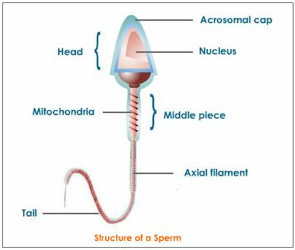
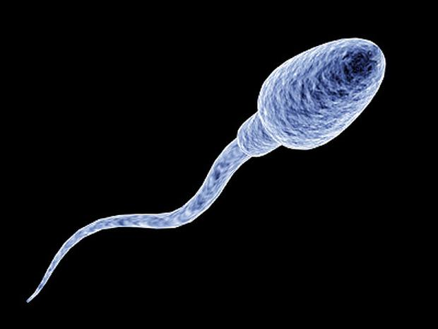
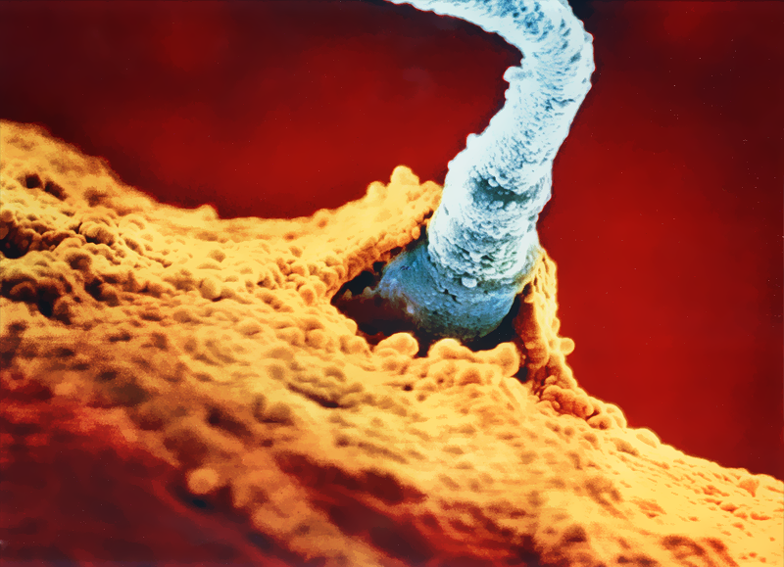

Slide 9
Besides seminiferous tubules, there are interstitial cells in the testis.
These cells produce the male hormone testosterone.
Notes:
Besides seminiferous tubules, there are interstitial cells in the testis.
These cells produce the male hormone testosterone.

Slide 10
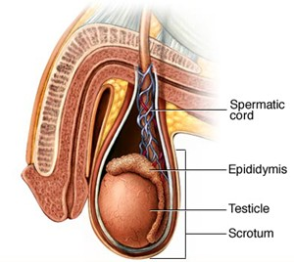
2. Epididymis
A tightly coiled duct which lies outside each testis.
Maturation of the sperm occurs here.
Notes:
2. Epididymis
A tightly coiled duct which lies outside each testis.
Maturation of the sperm occurs here.

Slide 11
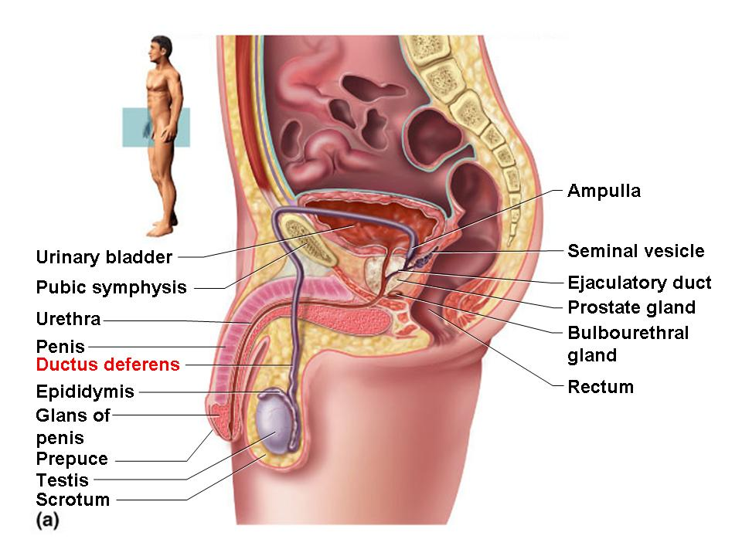
3. Vas deferens
A tube that carries the sperm,
Each vas deferens passes into the abdominal cavity where it curves around the bladder and empties into the ejaculatory duct which enters the urethra
Notes:
3. Vas deferens
A tube that carries the sperm,
Each vas deferens passes into the abdominal cavity where it curves around the bladder and empties into the ejaculatory duct which enters the urethra

Slide 12
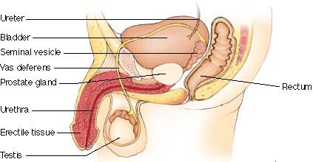
4. Seminal fluid glands
There are 3 glands that produce seminal fluid:
  1. Prostate gland: doughnut-shaped gland that surrounds the urethra
  2. Seminal vesicle: lie at the base of the bladder.
  3. Bulbourethral gland: pea-sized that lie on either side of the urethra.
Notes:
4. Seminal fluid glands
There are 3 glands that produce seminal fluid:
1. Prostate gland: doughnut-shaped gland that surrounds the urethra
2. Seminal vesicle: lie at the base of the bladder.
3. Bulbourethral gland: pea-sized that lie on either side of the urethra.

Slide 13
Components of seminal fluid
Basic solution: sperm are more viable and in addition it helps to neutralize the acidic environment of the vagina.
Fructose (sugar): sugar for the mitochondria to make ATP (energy).
Prostaglandins: a chemical that causes the uterus to contract. It brings the sperm closer to the egg for fertilization
Mucus: lubrication
Water: solvent
Notes:
Components of seminal fluid
Basic solution: sperm are more viable and in addition it helps to neutralize the acidic environment of the vagina.
Fructose (sugar): sugar for the mitochondria to make ATP (energy).
Prostaglandins: a chemical that causes the uterus to contract. It brings the sperm closer to the egg for fertilization
Mucus: lubrication
Water: solvent

Slide 14
5. Penis
Organ for sexual intercourse
A long shaft with an enlarged tip called the glans penis
Covered by a layer of skin called the foreskin
Male reproductive system
Notes:
5. Penis
Organ for sexual intercourse
A long shaft with an enlarged tip called the glans penis
Covered by a layer of skin called the foreskin
Male reproductive system

Slide 15
Ejaculation
Erection: blood sinuses in erectile tissue fill with blood.
Parasympathetic impulses dilate the arteries to fill up the erectile tissue and compress the veins so blood is not carried away.
The sperm enters the urethra from the vas deferens along with the seminal fluid.
The rhythmic muscle contractions expel the semen from the penis in spurts… this is the orgasm – climax of sexual stimulation.
During ejaculation the sphincter closes off the urinary bladder so no urine enters the urethra.
After ejaculation, the penis returns to a flaccid state.
Within one ejaculation, 400 million sperm are in approximately 2 to 6 ml of fluid.
Notes:
Ejaculation
Erection: blood sinuses in erectile tissue fill with blood.
Parasympathetic impulses dilate the arteries to fill up the erectile tissue and compress the veins so blood is not carried away.
The sperm enters the urethra from the vas deferens along with the seminal fluid.
The rhythmic muscle contractions expel the semen from the penis in spurts… this is the orgasm – climax of sexual stimulation.
During ejaculation the sphincter closes off the urinary bladder so no urine enters the urethra.
After ejaculation, the penis returns to a flaccid state.
Within one ejaculation, 400 million sperm are in approximately 2 to 6 ml of fluid.

Slide 16
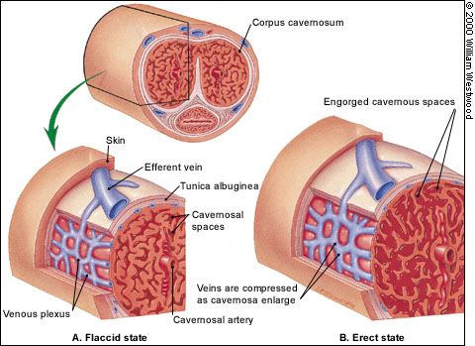

Slide 17
Hormonal regulation in males
Gonadotropin-releasing hormone (GnRH): secreted by the hypothalamus and it stimulates the anterior pituitary gland. It controls the testes’ sexual function
Follicle-stimulating hormone (FSH): secreted by the anterior pituitary gland. It promotes the production of sperm
Luteinizing hormone (LH) also known as interstitial cell-stimulating hormone (ICSH): secreted by the anterior pituitary gland. It promotes the production of testosterone.
Testosterone: male sex hormone
Notes:
Hormonal regulation in males
Gonadotropin-releasing hormone (GnRH): secreted by the hypothalamus and it stimulates the anterior pituitary gland. It controls the testes’ sexual function
Follicle-stimulating hormone (FSH): secreted by the anterior pituitary gland. It promotes the production of sperm
Luteinizing hormone (LH) also known as interstitial cell-stimulating hormone (ICSH): secreted by the anterior pituitary gland. It promotes the production of testosterone.
Testosterone: male sex hormone

Slide 18
hypothalamus
GnRH
Anterior pituitary gland
LH
FSH
Negative feedback
testis
LH
FSH
Interstitial cells
Seminiferous tubules
Testosterone production
Sperm production

Slide 19
Testosterone
The male sex hormone:
Functions:
  1.development and functions of primary sex organs.
  2.production of sperm (FSH)
  3.brings about and maintains secondary characteristics at puberty:
    Facial, axillary and pubic hair
    Vocal cords and larynx enlargement
  4. Muscular strength
  5.Stimulate secretion of oil and sweat glands
  6.Responsible for sex drive.
video
Notes:
Testosterone
The male sex hormone:
Functions:
1.development and functions of primary sex organs.
2.production of sperm (FSH)
3.brings about and maintains secondary characteristics at puberty:
Facial, axillary and pubic hair
Vocal cords and larynx enlargement
4. Muscular strength
5.Stimulate secretion of oil and sweat glands
6.Responsible for sex drive.
video

Slide 20
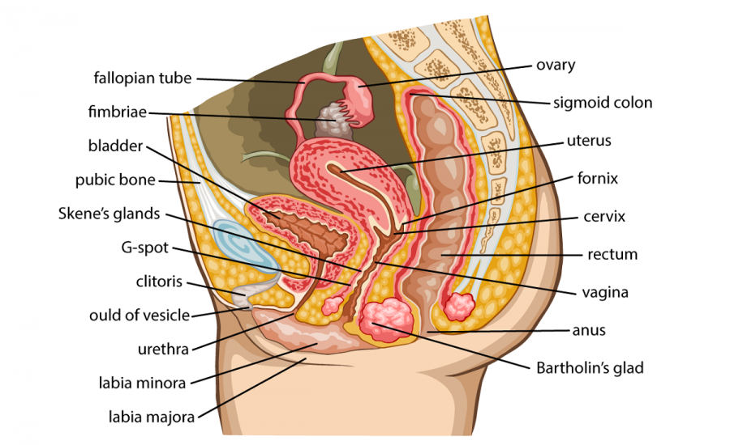
Female reproductive system

Slide 21
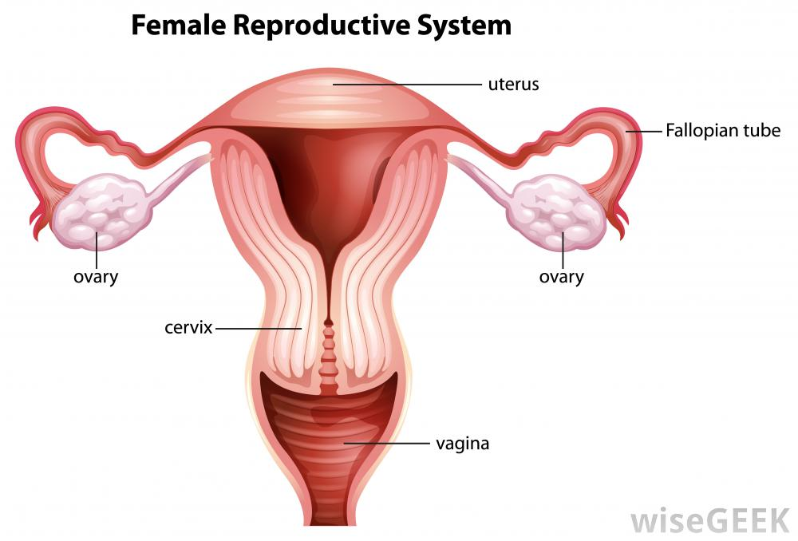
1. OVARIES
There is one on each side of the pelvic cavity.
The cortex of the ovary contains follicles (sac-like structures) that produce the egg.
A female is born with approximately 2 million follicles. At puberty there are 300,000 – 400,000 remaining and only 400 of those will mature.
Notes:
1. OVARIES
There is one on each side of the pelvic cavity.
The cortex of the ovary contains follicles (sac-like structures) that produce the egg.
A female is born with approximately 2 million follicles. At puberty there are 300,000 – 400,000 remaining and only 400 of those will mature.

Slide 22
Oogenesis : egg production
Primary follicle with primary oocyte
Secondary follicle with 2 secondary oocytes (1 degenerates)
Graafian follicle balloons out due to pressure and releases the egg – ovulation
https://www.youtube.com/watch?v=nLmg4wSHdxQ
After ovulation, the follicle becomes the corpus luteum
If pregnancy occurs it will secrete hormones for 3-6 months
If no pregnancy it will degenerate

Slide 23
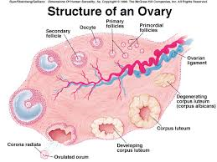

Slide 24
2. oviducts
Also the uterine or fallopian tubes
They connect the ovaries to the uterus.
Fimbriae: finger-like projections on the oviducts which sweep over the ovary moving the egg into the tubes. The cilia also assist with this.
The muscular contractions propel the egg to the uterus
It is here where egg maturation, fertilization and completion zygote formation occurs
Several days after the zygote will implant itself in the endometrium. (uterine lining)
Ectopic pregnancy: pregnancy that occurs outside the uterus
Notes:
2. oviducts
Also the uterine or fallopian tubes
They connect the ovaries to the uterus.
Fimbriae: finger-like projections on the oviducts which sweep over the ovary moving the egg into the tubes. The cilia also assist with this.
The muscular contractions propel the egg to the uterus
It is here where egg maturation, fertilization and completion zygote formation occurs
Several days after the zygote will implant itself in the endometrium. (uterine lining)
Ectopic pregnancy: pregnancy that occurs outside the uterus

Slide 25
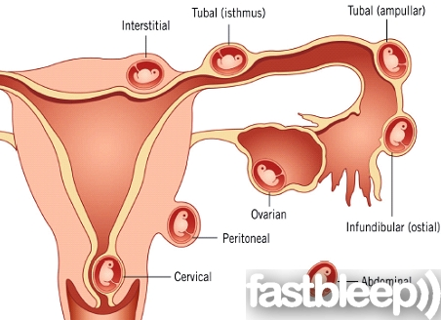
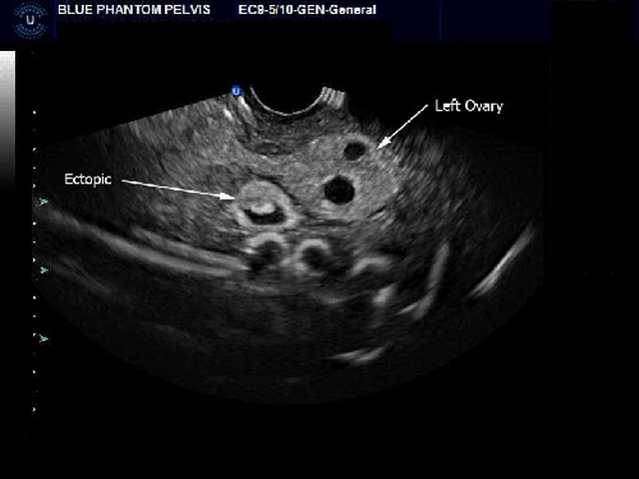
Ectopic pregnancy

Slide 26
3. uterus
Thick-walled muscular organ about the size of an inverted pear.
Is lies above the bladder.
The cervix dips down into the vagina.
It can stretch from 5 cm to 30 cm to accommodate the baby.
Notes:
3. uterus
Thick-walled muscular organ about the size of an inverted pear.
Is lies above the bladder.
The cervix dips down into the vagina.
It can stretch from 5 cm to 30 cm to accommodate the baby.

Slide 27
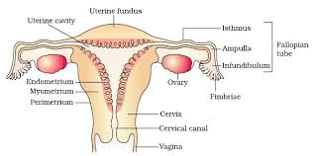
4. Vagina
A tube lined with folds of mucus membrane
Known as the birth canal.
Female reproductive system
Notes:
4. Vagina
A tube lined with folds of mucus membrane
Known as the birth canal.
Female reproductive system

Slide 28
Female orgasm
The clitoris is believed to be the organ of sexual stimulation.
The clitoris can become erect due to the erectile tissue that it contains.
the vaginal wall can also expand with blood. The pressure causes droplets of fluid to squeeze through the wall and lubricate the vagina.
The uterine motility may assist transport of sperm.
Notes:
Female orgasm
The clitoris is believed to be the organ of sexual stimulation.
The clitoris can become erect due to the erectile tissue that it contains.
the vaginal wall can also expand with blood. The pressure causes droplets of fluid to squeeze through the wall and lubricate the vagina.
The uterine motility may assist transport of sperm.

Slide 29
hypothalamus
GnRH
Anterior pituitary gland
LH
FSH
ovary
estrogen
progesterone

Slide 30
pregnancy
The developing embryo embeds itself in the endometrium after fertilization.
During implantation, the hormone HCG (human chorionic gonadotropin hormone) is produced by the chorion membrane surrounding the embryo.
It prevents corpus luteum degeneration and causes the progesterone to be secreted in larger quantities.
The progesterone inhibits the uterus motility and together with estrogen it prepares the breast for lactation
Notes:
pregnancy
The developing embryo embeds itself in the endometrium after fertilization.
During implantation, the hormone HCG (human chorionic gonadotropin hormone) is produced by the chorion membrane surrounding the embryo.
It prevents corpus luteum degeneration and causes the progesterone to be secreted in larger quantities.
The progesterone inhibits the uterus motility and together with estrogen it prepares the breast for lactation

Slide 31
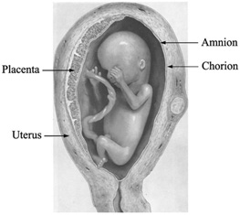

Slide 32
Pregnancy cont’d
The placenta forms where exchange between mother and baby occurs.
HCG continues to be produced.
Estrogen and progesterone are also produced in order to :
  1.shut down the anterior pituitary gland so no more follicles produce.
  2. maintains the uterine lining.
Notes:
Pregnancy cont’d
The placenta forms where exchange between mother and baby occurs.
HCG continues to be produced.
Estrogen and progesterone are also produced in order to :
1.shut down the anterior pituitary gland so no more follicles produce.
2. maintains the uterine lining.

Slide 33
Hormones: Estrogen & progesterone
1. at puberty stimulates the growth of uterus and vagina
2. egg maturation
3. secondary sex characteristics:
  Body hair
  Fat distribution to give curvy appearance
  Pelvic girdle enlarges
4. breast development
fertilization
Notes:
Hormones: Estrogen & progesterone
1. at puberty stimulates the growth of uterus and vagina
2. egg maturation
3. secondary sex characteristics:
Body hair
Fat distribution to give curvy appearance
Pelvic girdle enlarges
4. breast development
fertilization

Slide 34
Effects of hormones during pregnancy
Progesterone inhibits uterine motility
Progesterone and estrogen:
  1. prepares breasts for lactation
  2. shuts down ant. pituitary gland so no more follicle mature.
  3. maintains uterine lining (corpus luteum not needed).
  4. inhibits the release of PRL until delivery.
Notes:
Effects of hormones during pregnancy
Progesterone inhibits uterine motility
Progesterone and estrogen:
1. prepares breasts for lactation
2. shuts down ant. pituitary gland so no more follicle mature.
3. maintains uterine lining (corpus luteum not needed).
4. inhibits the release of PRL until delivery.

Slide 35
Female breasts: milk production
The nipple is surrounded by a pigmented area called the areola.
Each breast contains 15 – 25 lobules. Each lobule has its own mammary duct. Each duct divided into a blind-ended sac called the alveoli – milk is produced here.
Anatomy
https://www.youtube.com/watch?v=Fs4WsWfxTzM
Prolactin (PRL) is produced after delivery. Up until then it is inhibited by estrogen and progesterone.
After delivery, colostrum, a watery yellowish fluid is produced. It contains more protein than fat and is a source of passive immunity. A couple of days after birth, milk is produced.
Oxytocin: hormone for milk let down and labour

Slide 36
OVARIAN CYCLE | EVENTS | UTERINE CYCLE | EVENTS
Follicular Phase Days 1-13 | -The anterior pituitary gland secretes FSH stimulates the ovary follicle develops follicle secretes estrogen estrogen, by negative feedback inhibits FSH -Estrogen also causes positive feedback on the hypothalamus causing GnRH to be secreted -Momentarily after FSH and LH are secreted -There is a surge of LH which promotes ovulation | Menstrual Phase Days 1-5 | -A low level of sex hormones at this point Endometrium breaks down and blood vessels rupture menstruation
 |  | Proliferative Phase Days 6-13 | -Estrogen produced in follicle causing endometrium to build and thicken
Day 14 | Ovulation | Day 14 | Ovulation
Luteal Phase Days 15-28 | -The anterior pituitary secretes LH stimulates ovary corpus luteum develops. -Progesterone released which exerts a negative feedback decreases LH and FSH | Secretory Phase Days 15-28 | -Progesterone produced in the corpus luteum causes the endometrium to double in thickness and the uterine glands to mature this produces a thick secretion -If no pregnancy then the corpus luteum degenerates and the low level of hormones causes the uterine lining to break down menstrual discharge.

Slide 37
Ovarian cycle events: follicular phase (days 1-13)
The anterior pituitary gland secretes FSH stimulates the ovary follicle develops follicle secretes estrogen estrogen, by negative feedback inhibits FSH
Estrogen also causes positive feedback on the hypothalamus causing GnRH to be secreted
Momentarily after FSH and LH are secreted
There is a surge of LH which promotes ovulation
Notes:
Ovarian cycle events: follicular phase (days 1-13)
The anterior pituitary gland secretes FSH stimulates the ovary follicle develops follicle secretes estrogen estrogen, by negative feedback inhibits FSH
Estrogen also causes positive feedback on the hypothalamus causing GnRH to be secreted
Momentarily after FSH and LH are secreted
There is a surge of LH which promotes ovulation

Slide 38
Ovarian cycle: ovulation (day 14)

Slide 39
Ovarian cycle: luteal phase (day 15-28)
The anterior pituitary secretes LH stimulates ovary corpus luteum develops.
Progesterone released which exerts a negative feedback decreases LH and FSH
Notes:
Ovarian cycle: luteal phase (day 15-28)
The anterior pituitary secretes LH stimulates ovary corpus luteum develops.
Progesterone released which exerts a negative feedback decreases LH and FSH

Slide 40
Uterine cycle: menstrual phase (days 1-5)
A low level of sex hormones at this point
Endometrium breaks down and blood vessels rupture menstruation
Notes:
Uterine cycle: menstrual phase (days 1-5)
A low level of sex hormones at this point
Endometrium breaks down and blood vessels rupture menstruation

Slide 41
Uterine cycle: proliferative phase (days 6-13)
Estrogen produced in follicle causing endometrium to build and thicken
Notes:
Uterine cycle: proliferative phase (days 6-13)
Estrogen produced in follicle causing endometrium to build and thicken

Slide 42
Uterine cycle: secretory phase (day 15-28)
Progesterone produced in the corpus luteum causes the endometrium to double in thickness and the uterine glands to mature this produces a thick secretion
If no pregnancy then the corpus luteum degenerates and the low level of hormones causes the uterine lining to break down menstrual discharge.
Video https://www.youtube.com/watch?v=usEIVynA0Ck
Notes:
Uterine cycle: secretory phase (day 15-28)
Progesterone produced in the corpus luteum causes the endometrium to double in thickness and the uterine glands to mature this produces a thick secretion
If no pregnancy then the corpus luteum degenerates and the low level of hormones causes the uterine lining to break down menstrual discharge.
video

Slide 43
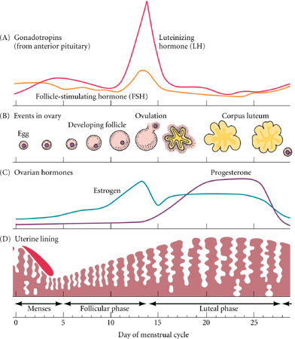

Slide 44
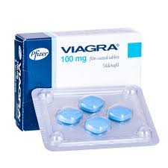
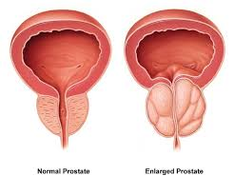
Disorders of the male reproductive system
Erectile Dysfunction (ED):
Inability to produce and maintain an erection.
Causes can be aging and conditions related to blood flow like high blood pressure and atherosclerosis and some medications such as alcohol and illicit drugs.
Benign prostatic hyperplasia (BPH):
Enlargement of the prostate gland
This can force the bladder to work harder since the gland swells up around the urethra.
Notes:
ED: 50% of men 40 to 75 years have experienced. Viagra, Cialis increase the blood flow during sexual arousal
BPH: difficult to urinate. Enlargemnet due to enzyme that promotes growth at puberty but it continues in the adult. Proscar inhibits the enzyme… can affect libido and ED. Surgery to reduce the prostrate or reduce pressure on urethra. Transurethral resection surgery scrapes away the innermost core of the gland using an instrutment inserted into urethral. Transurethral microwave thermotherapy uses microwaves to produce heat to reduce size of gland.

Slide 45
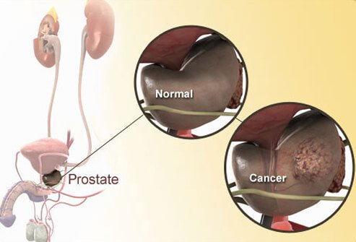
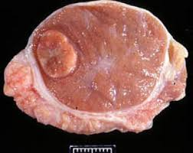
Prostate cancer:
1 in 7 men will get it
Will metastasize
Testicular cancer:
Most common type in men 15 to 35 years of age
Most curable if caught early on… 100%
Monthly testicular exams!
Notes:
Prostate cancer; 1 in 7 men. Prostate specific antigen (PSA) test in blood for early detection.

Slide 46
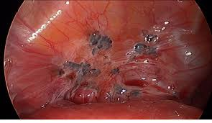
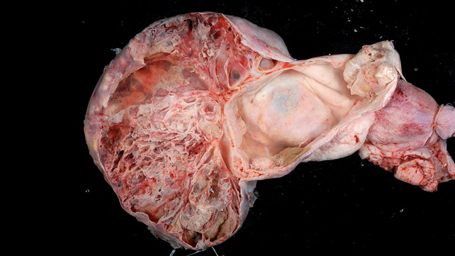
Conditions affecting female reproductive system
Endometriosis:
Presence of endometrial tissue outside the uterus…causes chronic pelvic pain
Can result in abnormal menstrual cycles or infertility.
Ovarian cancer:
Prognosis not as good as testicular
A silent cancer
Can test for tumor marker DA-125 a protein antigen
Surgery involves removal of both ovaries
Women who have never had children are twice as likely to get it.
Notes:
Endometriosis: 10 to 33 % of women aged 25 to 35
Tissue can grow on ovaries and on any other abdominal organ.
Initial treatment is pain control and oral contraceptives to inhibit ovulation
Ovarian cancer; 4% of all womens cancers in Canada. A silent cancer as it has no signs and symptoms until its advance stages. Survival is 5 years after

