Slide 1
Cardiovascular System
Anatomy and Physiology 12

Slide 2
Cardiovascular System
Consists of the:
Heart
Blood
Blood vessels

Slide 3
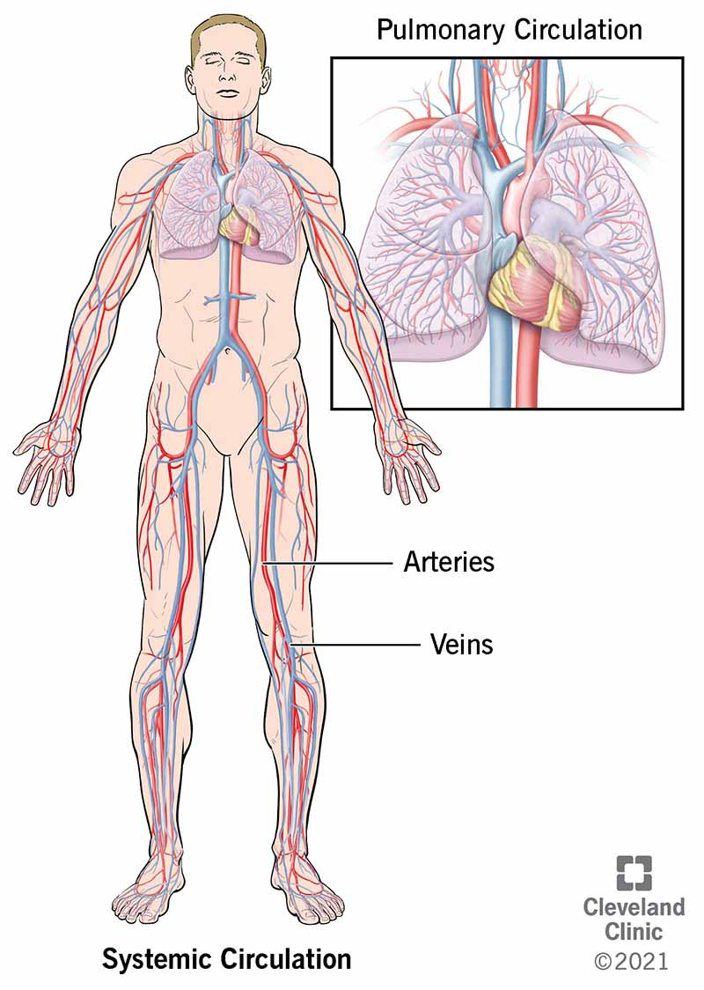
Blood Vessels
Blood Vessels carry blood to and from the heart.
Types of vessels
  Arteries
  Veins
  Capillaries

Slide 4
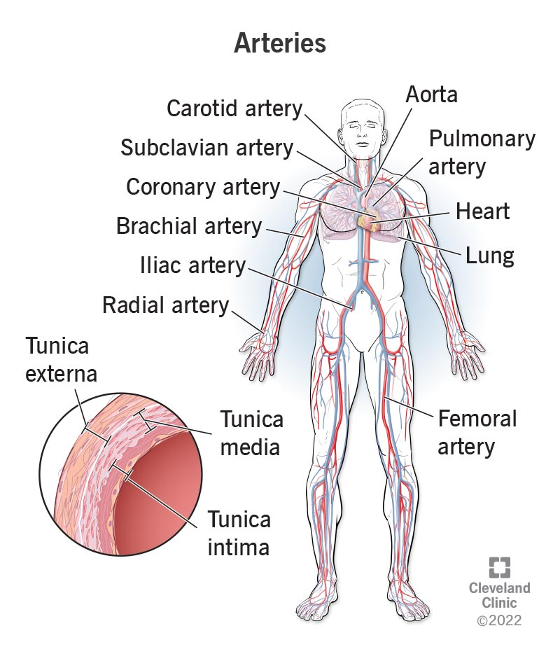
Blood Vessels
Arteries
Carry blood away from the heart
Arteries have thick walls to withstand the high blood pressure
Walls – outer connective tissue, middle is elastic and smooth muscle and inner is endothelium (lining)
The smooth muscle is under involuntary control

Slide 5
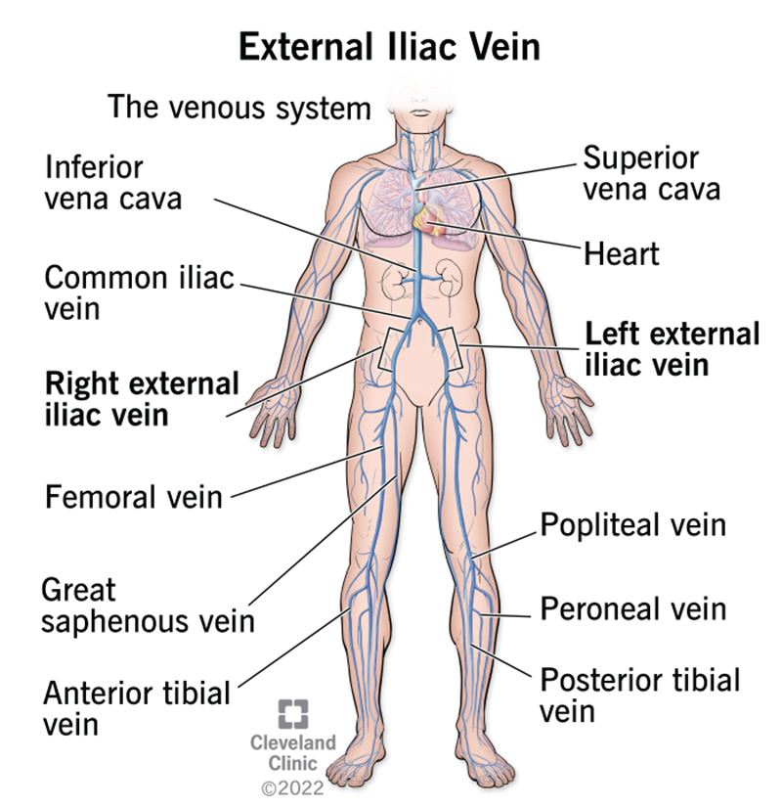
Blood Vessels
Veins
Thin walled vessels
Same layers as the artery but thinner
Has valves to prevent backflow and skeletal muscle to help push blood.

Slide 6
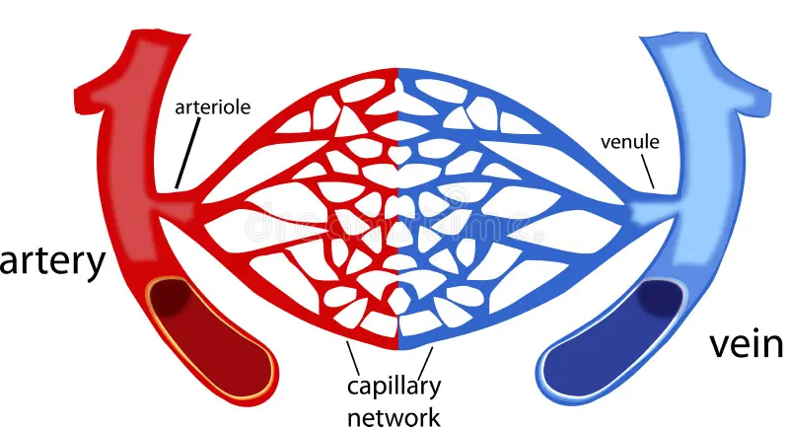
Blood Vessels
Capillaries
Smallest blood vessel where exchanges (gas, nutrient and waste) occurs
Consists of one layer of endothelial cells
Located everywhere in our body
Capillary beds are controlled by sphincters.
Low blood pressure that allows for exchange to occur.

Slide 7
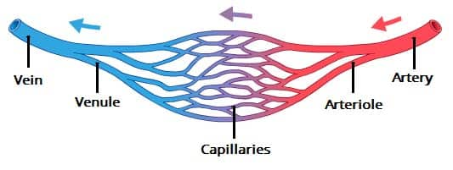
Blood Vessels
Arterioles
Venules
Small arteries
Small veins that take blood back to the heart

Slide 8
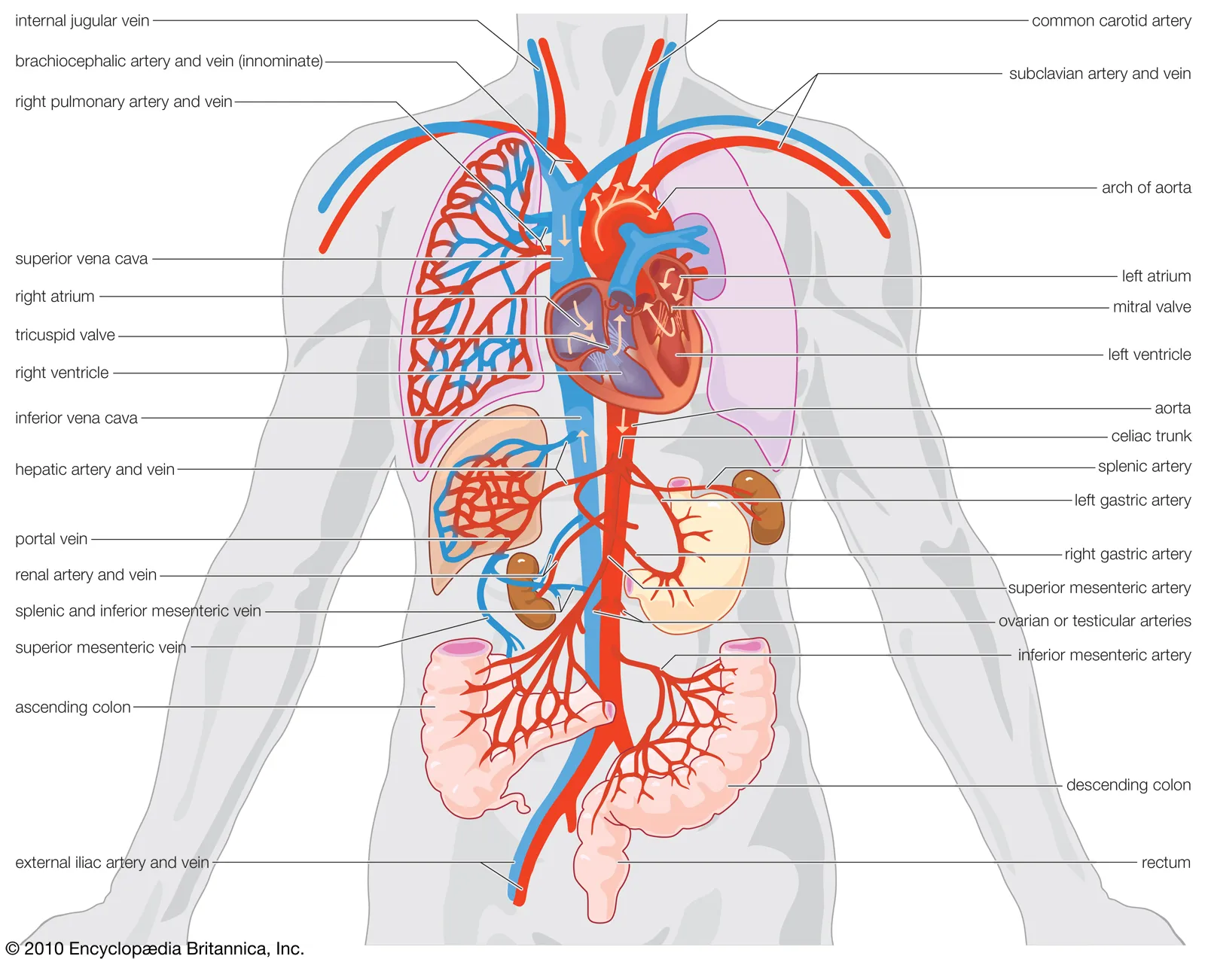
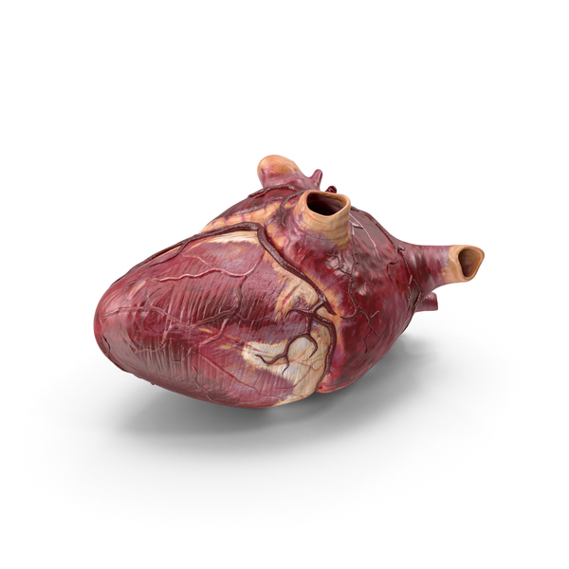
Heart
The Heart is cone-shaped and sits between lungs, slightly tilted
The heart has 4 chambers: right atrium, left atrium, right ventricle and left ventricle.

Slide 9
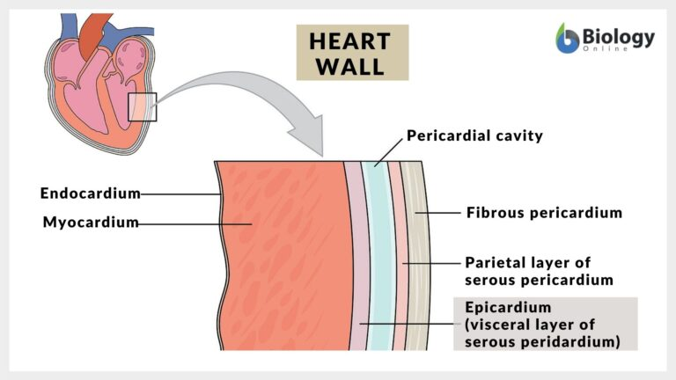
Heart
Myocardium: major part of heart – muscle
Endocardium: the inner surface of the chambers
Pericardium: the epithelial and fibrous tissue covering the heart… has liquid for lubrication.

Slide 10
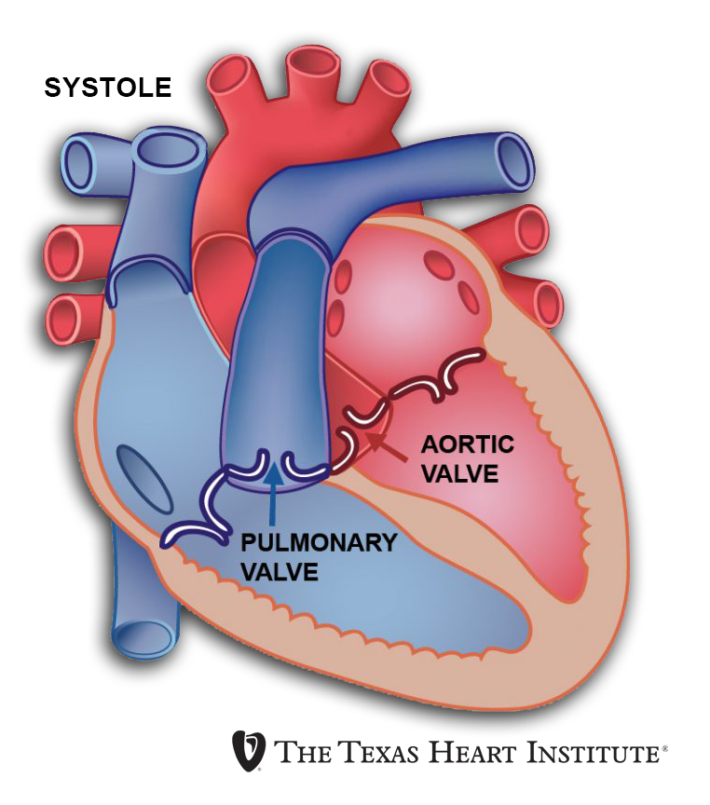
Heart
Valves-
The AV valves (atrioventricular) sit between the atrium and ventricle.
  The mitral valve lies between the left atria and the left ventricle.
  The tricuspid valve lies between the right atrium and the right ventricle.
Chordae tendinae: fibrous strings that support the valves

Slide 11
Heart
Valves-
Semilunar (SL) valves separate the ventricles from the great arteries
  The aortic valve lies between the left ventricles and the aorta.
  The pulmonary valve lies between the right ventricle and the pulmonary artery.

Slide 12
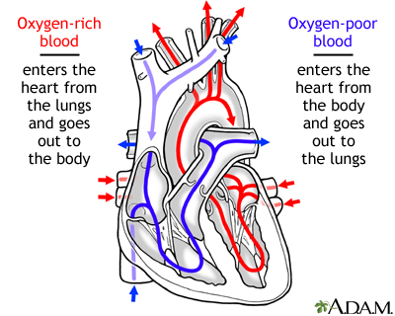
Heart
“The heart is a double pump “ … the right sends blood from the heart to the lungs and back. The left side sends blood to the body and back.
Why is the left side thicker than the right?
The left side pumps blood to the whole body

Slide 13
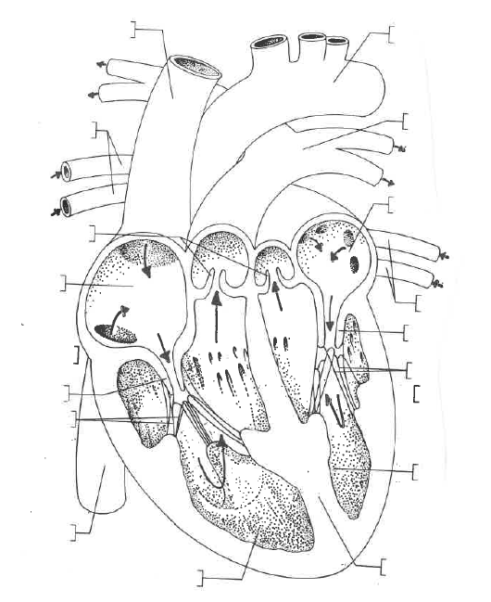
Superior vena cava
Aorta
Pulmonary veins
Pulmonary arteries
Left atrium
Semilunar valve
Right atrium
Pulmonary veins
AV valve
Right
Chordae tendineae
AV valve
Left
Chordae tendineae
Left ventricle
inferior vena cava
Septum
Right ventricle

Slide 14
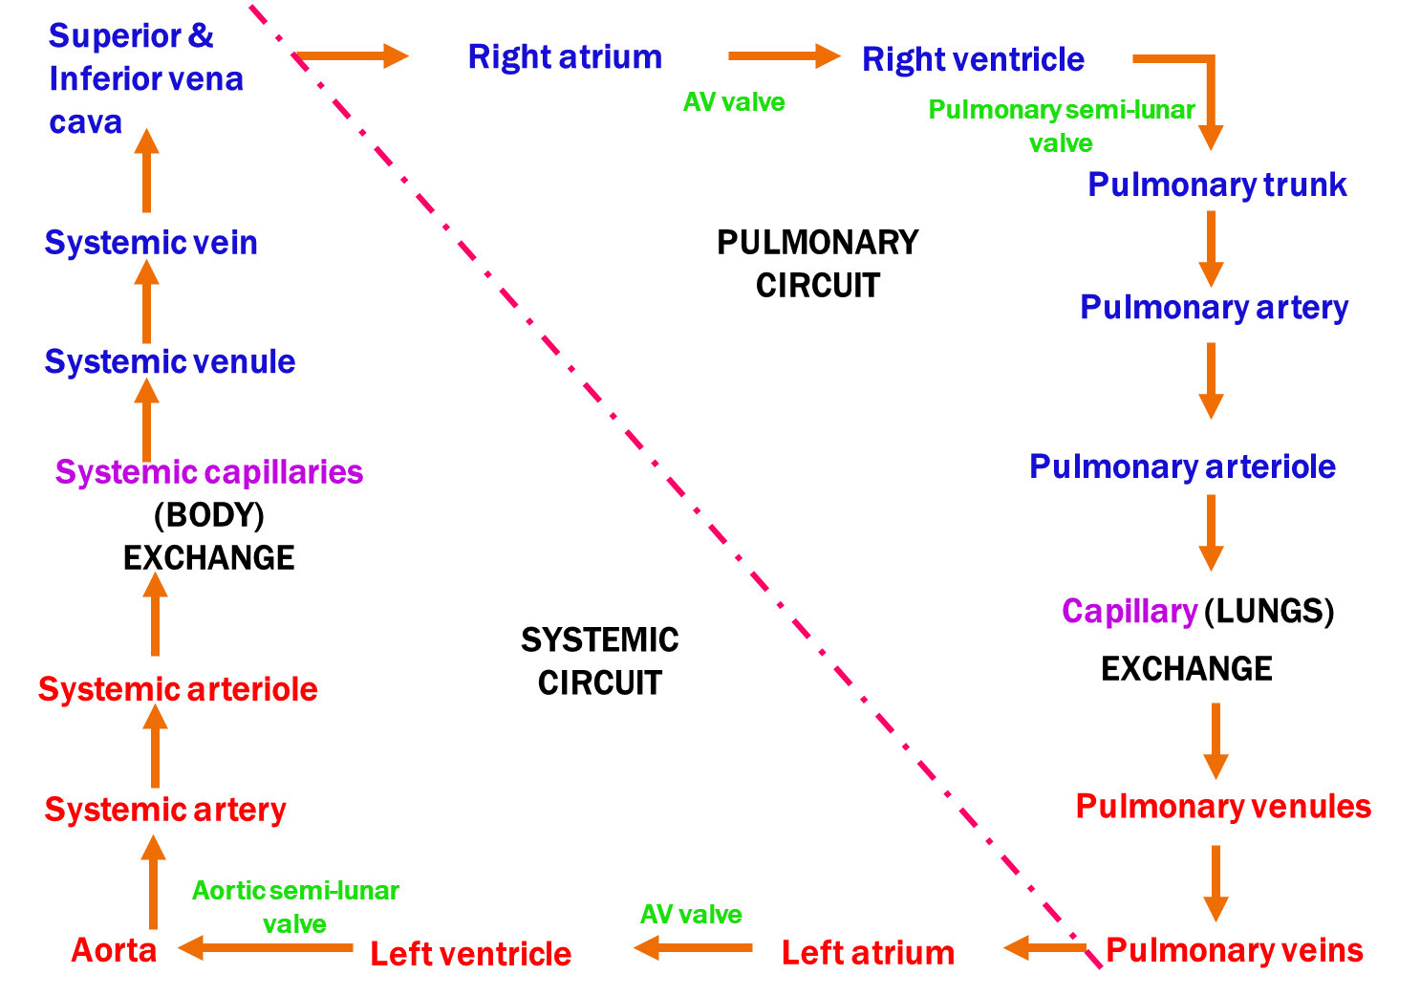

Slide 15
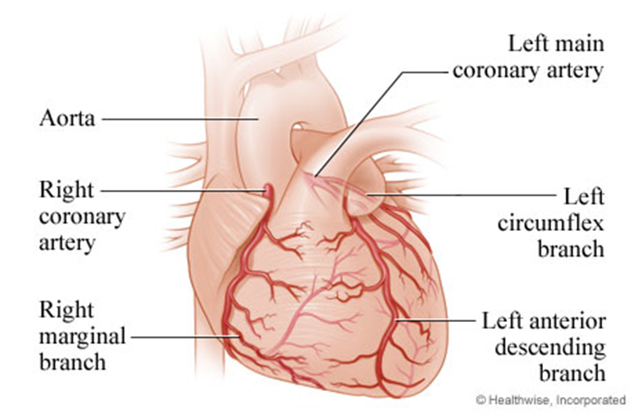
Coronary arteries
Coronary arteries:
  Supply the heart with blood
  It breaks off the aorta
  They lie on the heart
  It eventually empties into the right atrium

Slide 16
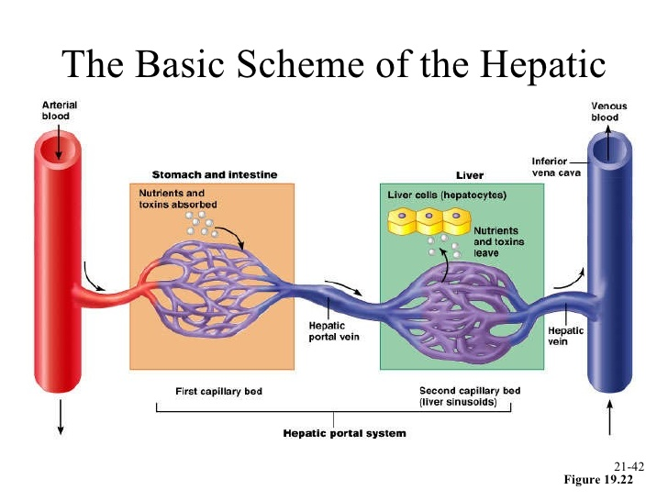
Portal system
Portal system
Begins and ends in capillaries
Capillaries from villi hepatic portal vein capillaries in the liver

Slide 18
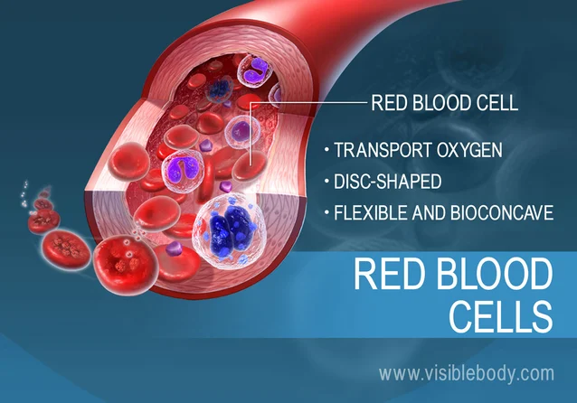
Blood
Blood has 3 functions:
  1) Transport
  2) Clotting
  3) Infection Fighting

Slide 19
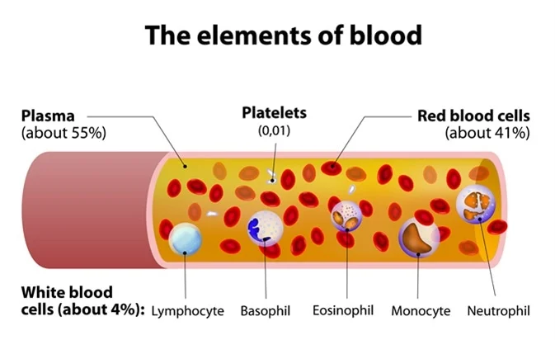
70% of our body weight is water
Most of it exists in the cells
Blood – 2 layers
  1) formed elements – erythrocytes (red blood cells), leukocytes (white blood cells), platelets
  2) plasma – organic and inorganic substances

Slide 20
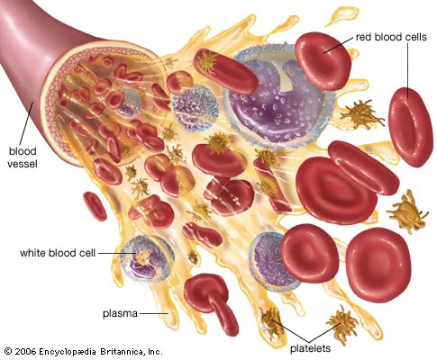
Blood Proteins
Transports hormones, lipids, vitamins and Maintains viscosity (thickness) of blood
Proteins and salts create osmotic pressure

Slide 21
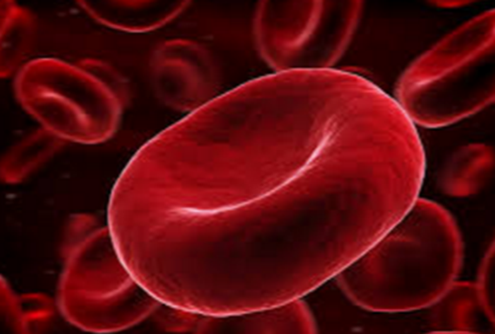
Transport-Red Blood Cells
Small biconcave, disc-shaped cells with no nuclei
They are manufactured in the red bone marrow of the skull, ribs, vertebrae and end of long bones.
Red blood cells (RBC) and hemoglobin production stops when the oxygen concentration of the arterial blood is high
At high altitudes the oxygen tension is low so RBC production is high.

Slide 22
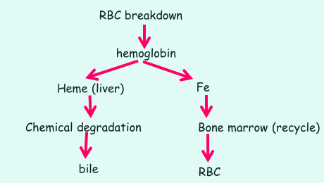
Blood-Breakdown
Red blood cells live 120 days and are destroyed in the liver and spleen (phagocytic cells)

Slide 23
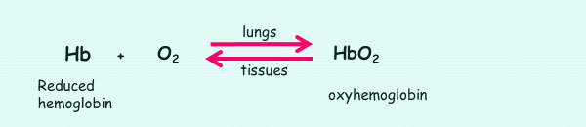
Blood-Oxygen
Our brain always needs oxygen
It holds hemoglobin which has a heme complex that has Fe (bonds to oxygen).
Hemoglobin easily carries oxygen in cool, neutral conditions and gives it up in the tissues in the warm, acid environment.

Slide 24
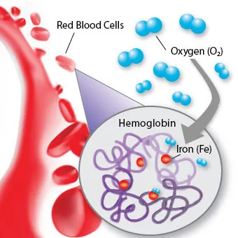
Hemoglobin
Hemoglobin is enclosed within the RBC
Each RBC has 200 million hemoglobin molecules
Each hemoglobin has 4 polypeptide chains and each polypeptide chain has a heme complex (Fe)
Hemoglobin prefers CO (carbon monoxide) more than oxygen.

Slide 25
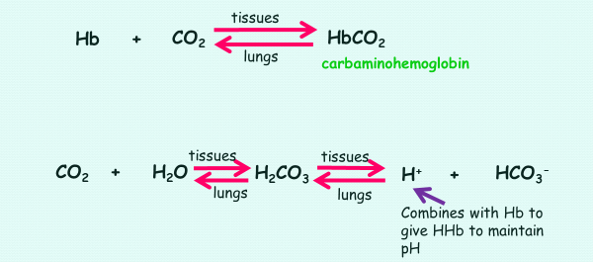
Blood- Carbon Dioxide
Carbon dioxide is transported by hemoglobin but in small amounts only.
Most of CO2 is transported to the lungs as HCO3- (bicarbonate ion)

Slide 26
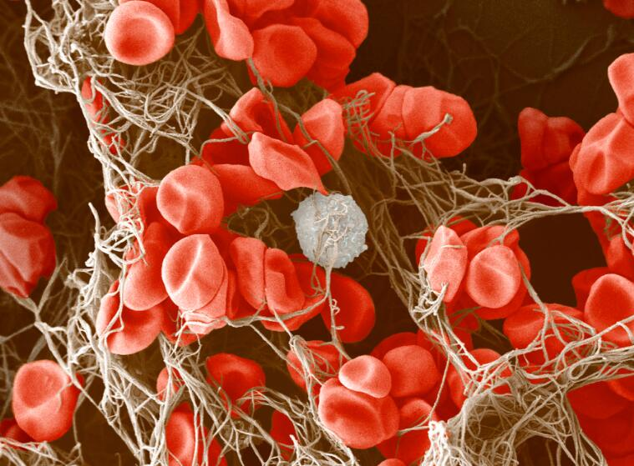
Clotting
Clotting: coagulation of blood to prevent bleeding
What is needed:
1) platelets: fragments of megakaryocytes - ~200 billion/ day
2) prothrombin – blood protein
3) fibrinogen – blood protein

Slide 27
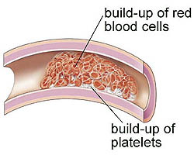
Clotting
Calcium (Ca2+) is required for clotting
Clotting takes place faster in a warmer environment
Serum: yellowish fluid that lies above the clotted material. It contains everything in plasma except fibrin.
Plasmin: destroys the network clot so the clot won’t act as an embolus (travelling clot)

Slide 28
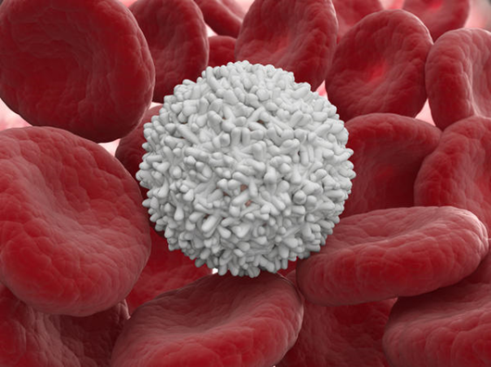
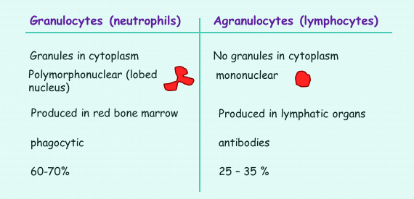
Infection Fighting
Leukocytes
Large and have a nucleus

Slide 29
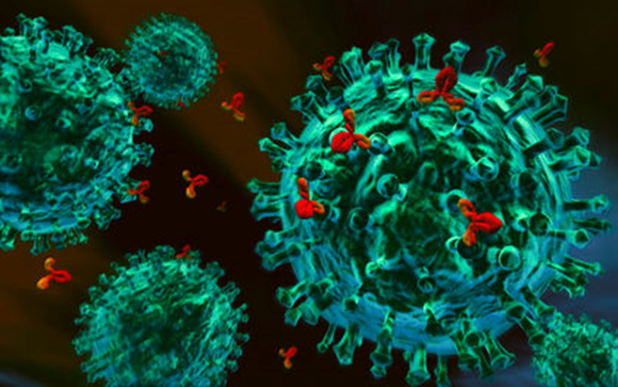
Infection fighting
Antibodies are specific to antigens
Lymphocytes produce them in response to foreign agents
Antigens: the protein on the outside of a foreign agent (bacteria, toxin, virus etc)
The fit is like a lock and key

Slide 30
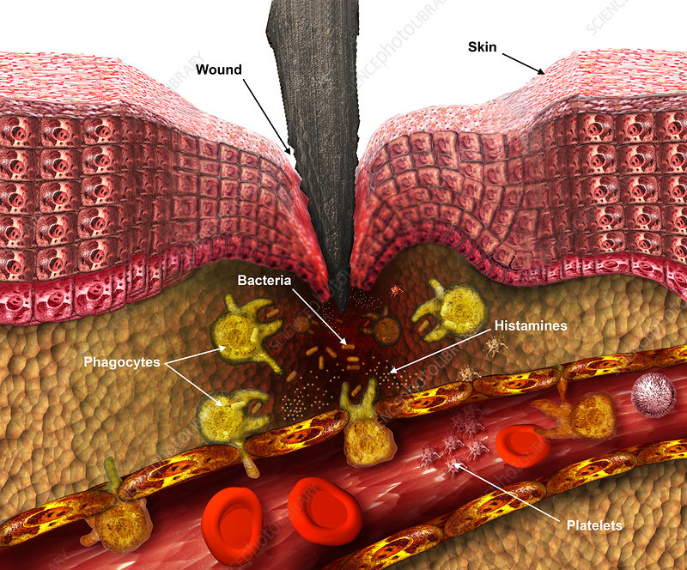
Infection fighting
Inflammatory Reaction
This occurs whenever our tissue have been exposed to the external pathogens ie cutting your finger
1) chemicals are released that activate our immune and nervous system
2) lymphocytes release antibodies to attack pathogens.
3) phagocytosis occurs
4) PUS = dead neutrophils, dead tissue, bacteria, living cells…. This indicates the body is overcoming infection

Slide 31
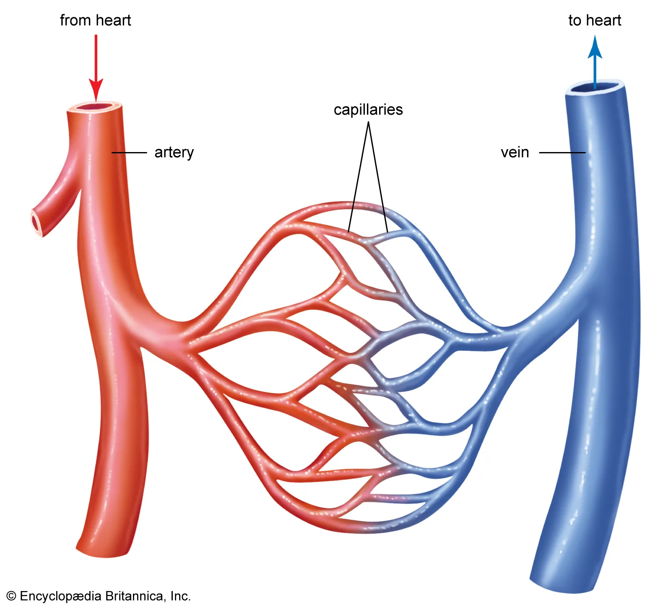
Blood- capillary exchange
Arterial side
Rich in oxygen and nutrients
Blood pressure is higher than osmotic pressure so oxygen and nutrients enter the tissues
Venous side
Rich in carbon dioxide and wastes
Blood pressure is lower than osmotic pressure so wastes and carbon dioxide moves into the capillaries from the tissues

Slide 32
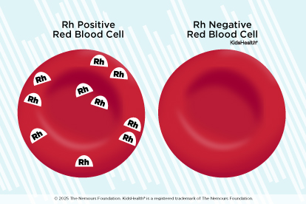
Blood typing
Rh factor = protein
+ if you have it
- if you do not have it
A + person can’t donate to a – person
Rule of thumb
same antigen x same antibody = agglutination

Slide 33
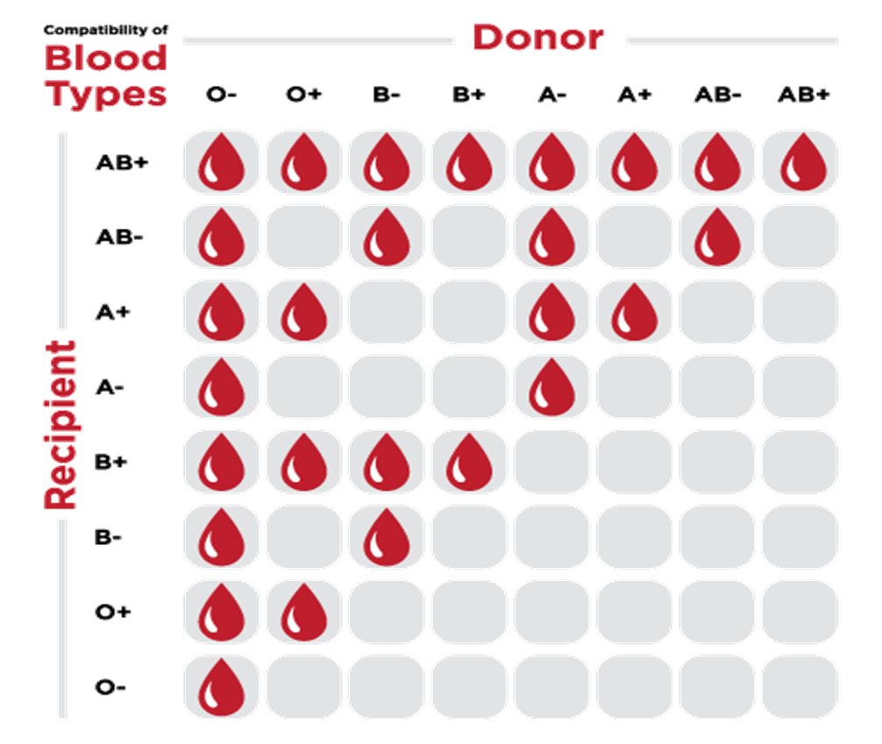

Slide 34
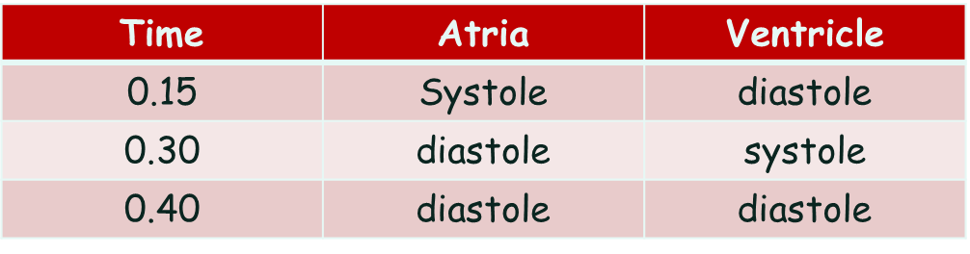
Heartbeat
Contraction occurs together
Systole: contraction of heart muscle
Diastole: relaxation of heart muscle
The heart beats 70 times/min
One heartbeat = cardiac cycle

Slide 35
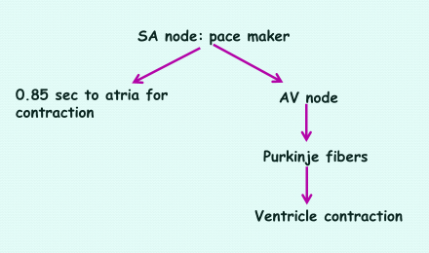
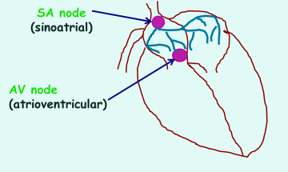
Control of Heartbeat
Due to nodal tissue
It is independent of nerve tissue therefore called intrinsic

Slide 36
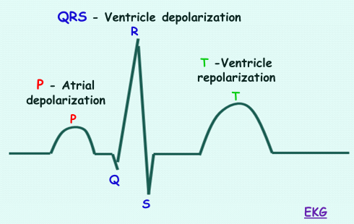
Electrocardiogram (EKG)
Measuring a heartbeat using the ionic changes that occur in the heart (voltage).

Slide 37
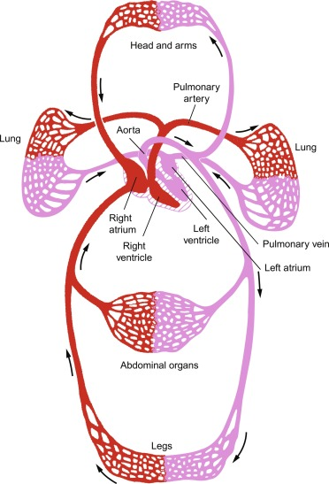
Velocity and Blood Flow
The velocity varies in different parts of the body.
The blood pressure (bp) accounts for the velocity. So the blood velocity decreases due to the cross-sectional area.
Low bp in the capillaries for exchange.
Skeletal muscle contraction helps to push blood in the veins and the valves prevent back flow

Slide 38
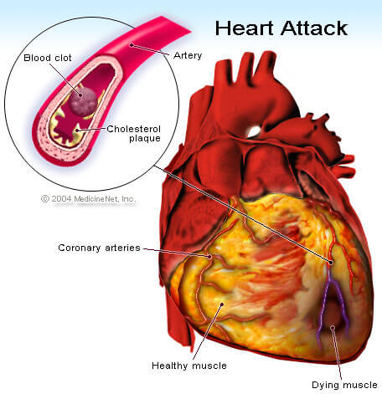
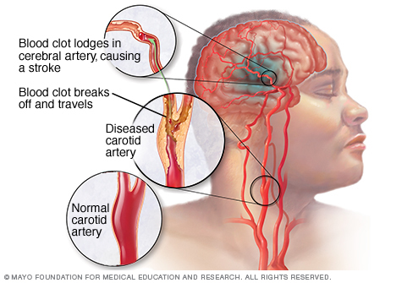
Disorders
Heart attack (myocardial infarction) occurs when the coronary blood vessel is completely blocked, a portion of the heart muscle dies due to a lack of oxygen.
stroke occurs when an arteriole bursts or is blocked by an embolus in the brain

Slide 39
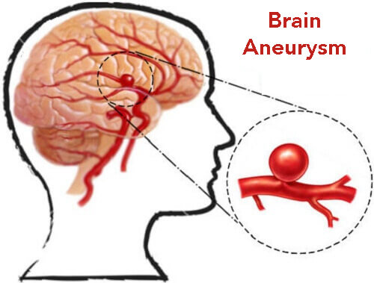
Disorders
Aneurysm is the ballooning of a blood vessel, usually abdominal aorta or arteries leading to the brain. Half the victims die before reaching a hospital.
Artherosclerosis is an accumulation of fatty materials (cholesterol) under the lining of the arteries.
Hypertension: high blood pressure. This may not be detected until a stroke or heart attack occurs.
If often is a result of artherosclerosis.

Slide 40
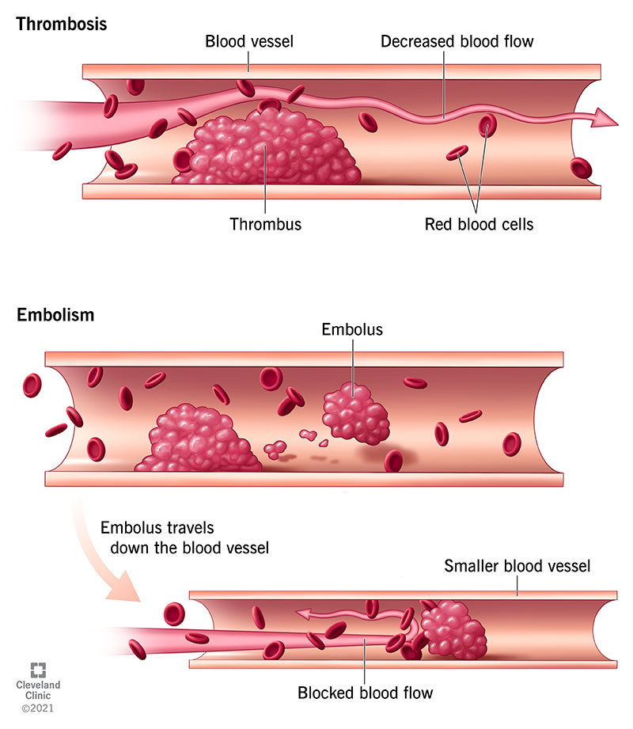
Disorders
Thrombus: stationary clot
Embolus: clot that moves with the blood
Thromboembolism: a clot that moved with the bloodstream but is now lodged in a blood vessel

Slide 41
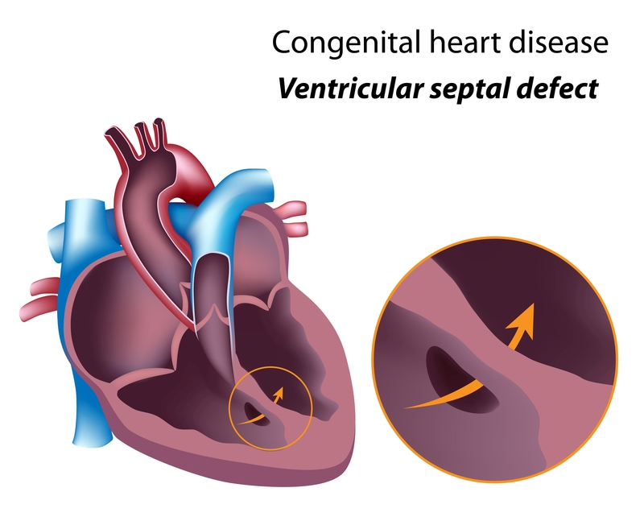
Disorders
Congenital Heart Defects: Structural issues present at birth that can affect the heart's normal function.
  Such as a Heart Murmur
Cardiomyopathy: A disease of the heart muscle that can lead to heart failure and arrhythmias, often due to genetics, infections, or other factors.

Slide 42
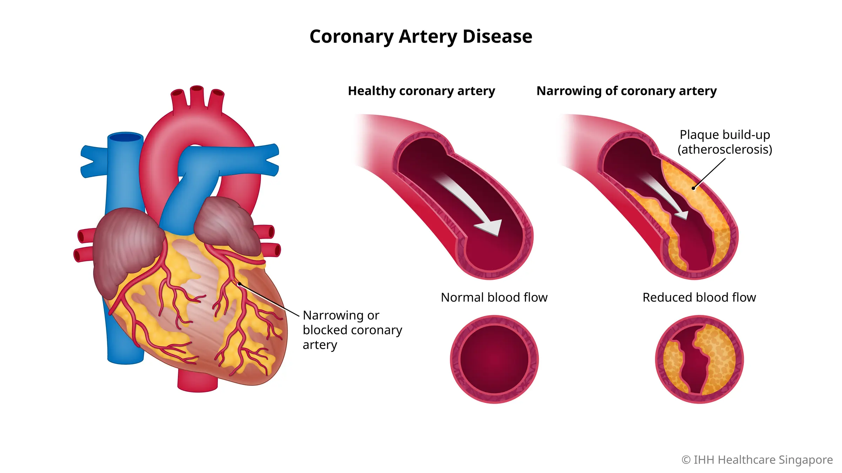
Disorders
Coronary Artery Disease (CAD): Narrowing or blockage of the coronary arteries due to plaque buildup, which can lead to chest pain (angina) or heart attacks.
Hypertension (High Blood Pressure): Elevated blood pressure can strain the heart and arteries, increasing the risk of heart disease, stroke, and kidney problems.

Slide 43
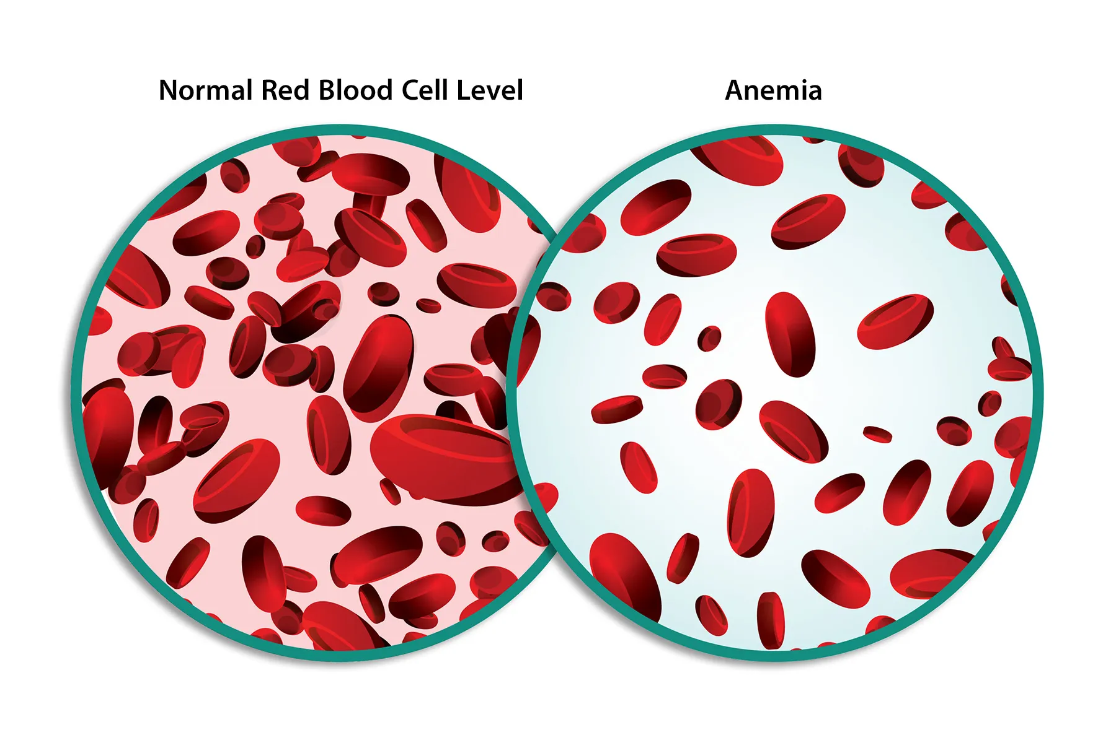
Disorders-Anemia
Iron-Deficiency Anemia:
  The most common type, often due to insufficient iron intake, blood loss (e.g., from menstruation or gastrointestinal bleeding), or increased demand (e.g., during pregnancy).

Slide 44
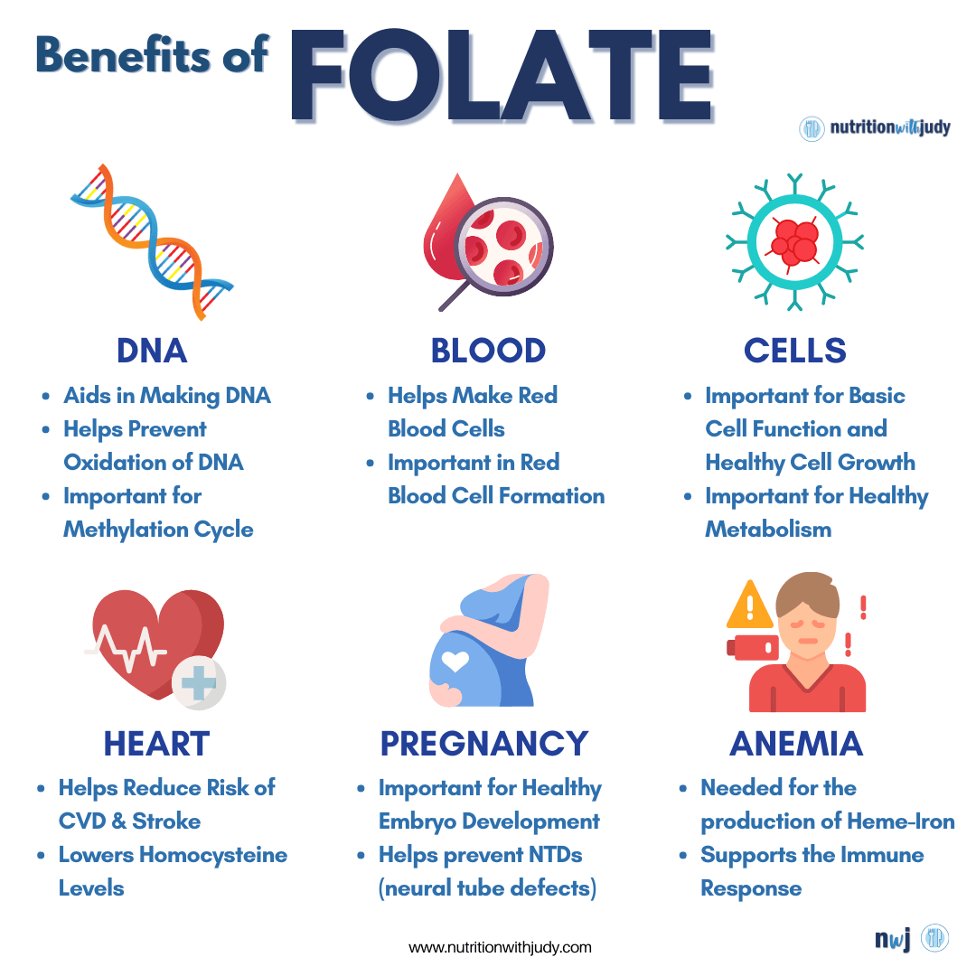
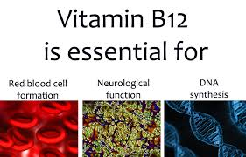
Disorders-Anemia
Vitamin Deficiency Anemia:
  Caused by a lack of essential vitamins, particularly vitamin B12 and folate, which are crucial for red blood cell production.

Slide 45
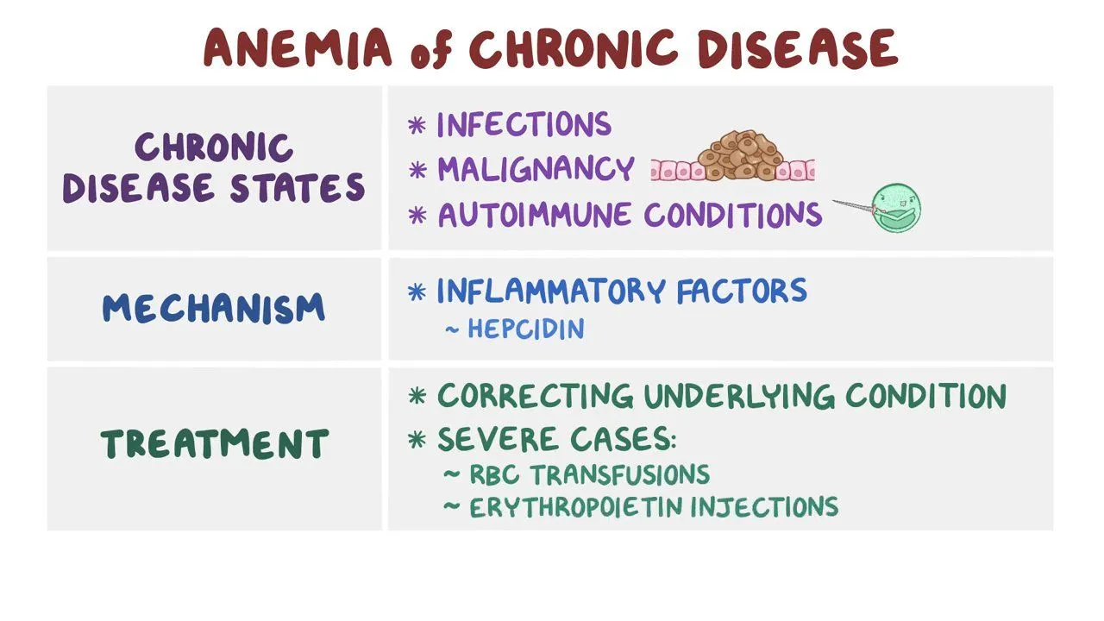
Disorders-Anemia
Chronic Disease Anemia:
  Associated with chronic diseases such as kidney disease, cancer, or inflammatory disorders, where the body’s ability to produce red blood cells is impaired.

Slide 46
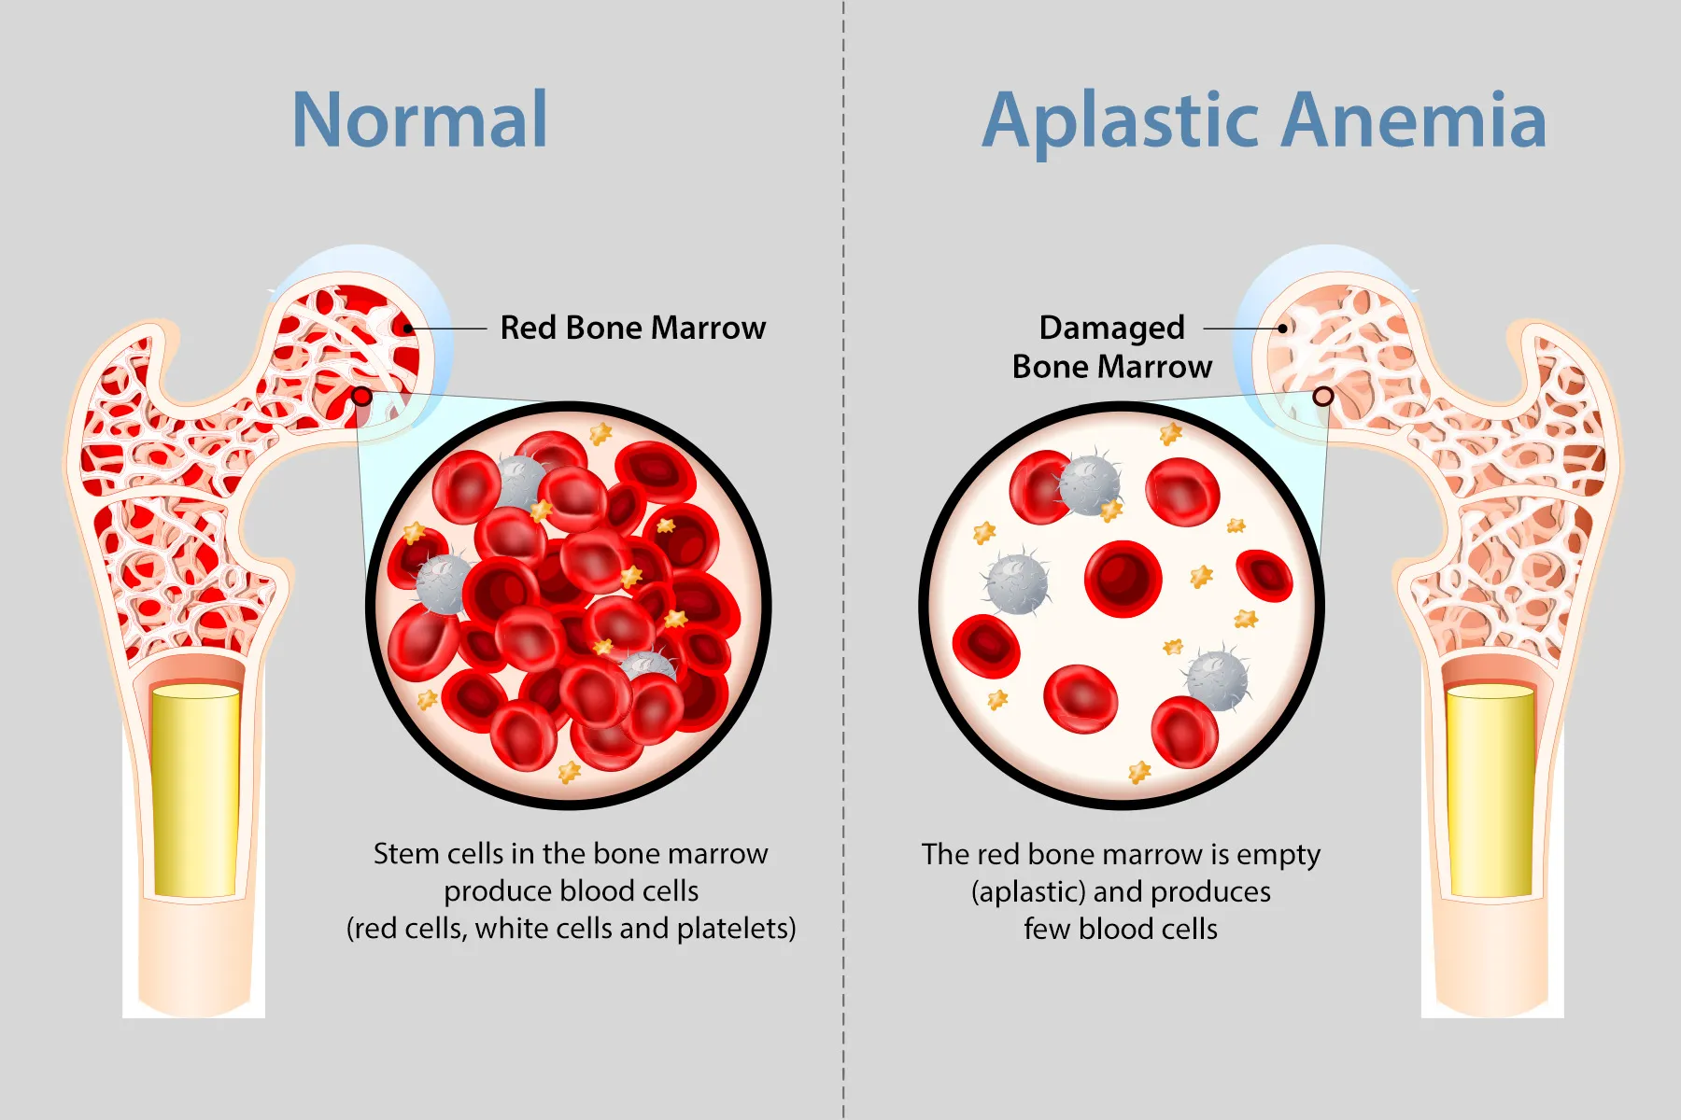
Disorders-Anemia
Aplastic Anemia:
  A rare condition where the bone marrow fails to produce sufficient blood cells due to factors like autoimmune diseases, infections, or exposure to toxins.

Slide 47
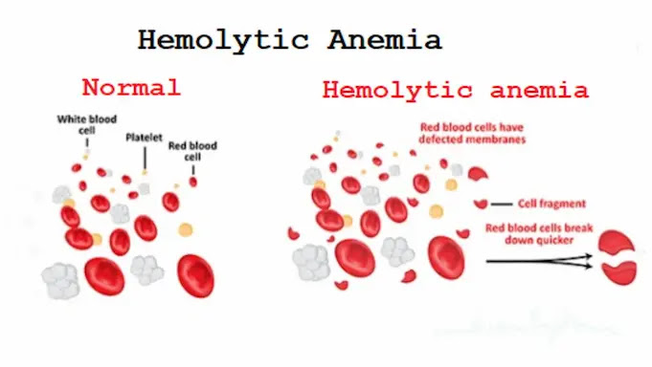
Disorders-Anemia
Hemolytic Anemia:
  Occurs when red blood cells are destroyed faster than the body can produce them, due to conditions like autoimmune disorders or inherited diseases (e.g., sickle cell anemia).

