Slide 1
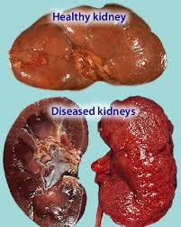
THE EXCRETORY SYSTEM

Slide 2
Excretory organs & products
Excretion: the process that rids the body of the metabolic wastes (especially nitrogenous)
Kidneys – excretes ammonia, urea, uric acid & creatinine
Liver – excretes bile pigments
Lungs – excretes CO₂ and water (breath)
Skin - excretes water, salt and some urea (sweat)
Intestines – gets rid of ions but these are not metabolic waste products ie Fe⁺, K⁺, Na⁺, Ca²⁺
Notes:
Excretory organs & products
Excretion: the process that rids the body of the metabolic wastes (especially nitrogenous)
Kidneys – excretes ammonia, urea, uric acid & creatinine
Liver – excretes bile pigments
Lungs – excretes CO₂ and water (breath)
Skin - excretes water, salt and some urea (sweat)
Intestines – gets rid of ions but these are not metabolic waste products ie Fe⁺, K⁺, Na⁺, Ca²⁺

Slide 3
Other nitrogenous wastes
Urea is mainly the waste product for humans.
Ammonia (NH₃) comes from the deamination of
amino groups. Its very toxic to tissues so land mammals convert it to urea in the liver.
Creatinine comes from creatinine phosphate in muscle metabolism.
Uric acid is found in organisms that live in environments where conservation of water is important. They “drop” crystals of uric acid.
Notes:
Other nitrogenous wastes
Urea is mainly the waste product for humans.
Ammonia (NH₃) comes from the deamination of
amino groups. Its very toxic to tissues so land mammals convert it to urea in the liver.
Creatinine comes from creatinine phosphate in muscle metabolism.
Uric acid is found in organisms that live in environments where conservation of water is important. They “drop” crystals of uric acid.

Slide 4
Urinary System
1. Kidneys
  Reddish, brown organs located dorsally on both sides of the midline.
  They are about 3” high, 2” wide and 1” thick.
  There are 3 sections:
    i. renal cortex: outer layer
    ii. renal medulla: middle layer (radially striated)
    iii. renal pelvis: inner layer where urine collects.
  There are a million nephrons that make up a kidney
Notes:
Urinary System
1. Kidneys
Reddish, brown organs located dorsally on both sides of the midline.
They are about 3” high, 2” wide and 1” thick.
There are 3 sections:
i. renal cortex: outer layer
ii. renal medulla: middle layer (radially striated)
iii. renal pelvis: inner layer where urine collects.
There are a million nephrons that make up a kidney

Slide 5
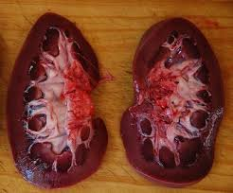
Renal cortex
Renal medulla
Renal pelvis

Slide 6
2. Ureter
  A muscular tube that transports urine from kidney to the urinary bladder. It is released in “jets”.
3. Urinary bladder
  A muscular structure that hold urine. It can hold up to 600 ml
4. Urethra
  A tube that transports urine from the bladder to the outside.
    Female: its about 1 inch long which makes women more susceptible to bacterial invasions.
    Male: its about 6 inches long and is surrounded by the prostate gland. It has a dual purpose in the male it carries urine as well as semen (reproductive system)
Notes:
2. Ureter
A muscular tube that transports urine from kidney to the urinary bladder. It is released in “jets”.
3. Urinary bladder
A muscular structure that hold urine. It can hold up to 600 ml
4. Urethra
A tube that transports urine from the bladder to the outside.
Female: its about 1 inch long which makes women more susceptible to bacterial invasions.
Male: its about 6 inches long and is surrounded by the prostate gland. It has a dual purpose in the male it carries urine as well as semen (reproductive system)

Slide 7
Urinary System
kidney
ureter
urinary bladder
urethra

Slide 8
Efferent arteriole
Proximal convoluted tubule
Glomerular capsule
Distal convoluted tubule
Collecting duct
glomerulus
Afferent arteriole
Peritubular capillary network
Renal artery
Loop of nephron (henle)
Renal vein
The Nephron
video

Slide 9
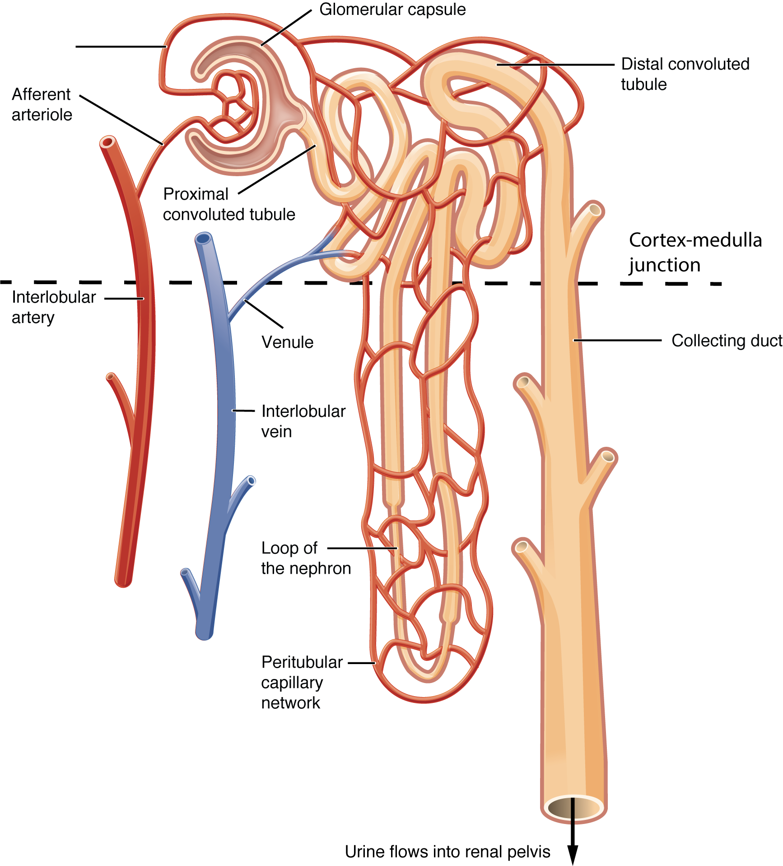

Slide 10
Urine Formation
Three processes to urine formation:
  1. Pressure (glomerular) filtration
  2. Tubular (selective) reabsorption
  3. Tubular secretion (excretion)
In between are two minor processes
Notes:
Urine Formation
Three processes to urine formation:
1. Pressure (glomerular) filtration
2. Tubular (selective) reabsorption
3. Tubular secretion (excretion)
In between are two minor processes

Slide 11
1. Pressure filtration ( Bowmans capsule)
High blood pressure in glomerulus (~60mm Hg) forces small molecules [*H₂O, nitrogenous wastes, *nutrients, *ions (salts)] into bowman`s capsule.
*note: we don't want to lose these substances constantly- we would quickly die of dehydration and starvation. Therefore, these substances must be absorbed back into the blood.
Large molecules are unable to pass (i.e. blood cells, platelets, proteins). These remain in the blood and leave the glomerulus via efferent arteriole.
The small, filterable molecules that are forced into Bowman's capsule form filtrate.
high blood pressure is necessary for filtration. This is accomplished through the functioning of the juxtaglomerular apparatus (a special region of afferent arteriole) and will, if necessary, release renin to increase blood pressure.
Notes:
1. Pressure filtration ( Bowmans capsule)
High blood pressure in glomerulus (~60mm Hg) forces small molecules [*H₂O, nitrogenous wastes, *nutrients, *ions (salts)] into bowman`s capsule.
*note: we don't want to lose these substances constantly- we would quickly die of dehydration and starvation. Therefore, these substances must be absorbed back into the blood.
Large molecules are unable to pass (i.e. blood cells, platelets, proteins). These remain in the blood and leave the glomerulus via efferent arteriole.
The small, filterable molecules that are forced into Bowman's capsule form filtrate.
high blood pressure is necessary for filtration this is accomplished through the functioning of the juxtaglomerular apparatus (a special region of afferent arteriole) and will, if necessary, release renin to increase blood pressure.

Slide 12
2. Tubular Reabsorption (proximal convoluted tubule)
The process of moving “good” molecules (nutrients) from the pct back into the blood stream (peritubular capillary network).
Interesting tidbit: This is very efficient. Every minute about 1300 mL of blood enters the kidneys and 1299 mL of blood leaves. Only about 1 mL becomes urine.
Reabsorbed: most H₂O, nutrients, some salts (Na⁺ Cl⁻)
Not reabsorbed: some H₂O, wastes, excess salts
This process involves both active (ATP, carrier) and passive reabsorption.
Cells here have lots of mitochondria (ATP) and a microvilli (increase surface area)
video
Notes:
2. Tubular Reabsorption (proximal convoluted tubule)
The process of moving “good” molecules (nutrients) from the pct back into the blood stream (peritubular capillary network).
Interesting tidbit: This is very efficient. Every minute about 1300 mL of blood enters the kidneys and 1299 mL of blood leaves. Only about 1 mL becomes urine.
Reabsorbed: most H₂O, nutrients, some salts (Na⁺ Cl⁻)
Not reabsorbed: some H₂O, wastes, excess salts
This process involves both active (ATP, carrier) and passive reabsorption.
Cells here have lots of mitochondria (ATP) and a microvilli (increase surface area)
video

Slide 13
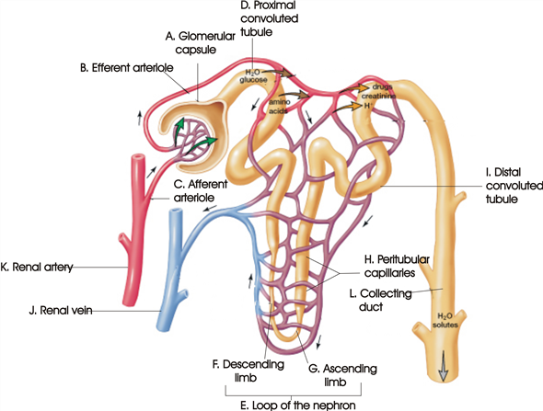

Slide 14
Minor process in Loop of Henle
Tubular fluid now enters the LOOP OF HENLE
Primary role of Loop of Henle is reabsorption of water.
Over 99% of the water in original filtrate is reabsorbed by the nephron during urine formation.
salt (Na+Cl-) is also passively and actively reabsorbed. This concentrates the urine, allowing it to be hypertonic to plasma
The surrounding medulla tissues are concentrated with NaCl and urea
In the ascending limb NaCl leaves (to make the medulla concentrated) and as a result, water leaves the descending limb and enters the surrounding capillaries.
video
Notes:
Minor process in Loop of Henle
Tubular fluid now enters the LOOP OF HENLE
Primary role of Loop of Henle is reabsorption of water.
Over 99% of the water in original filtrate is reabsorbed by the nephron during urine formation.
salt (Na+Cl-) is also passively and actively reabsorbed. This concentrates the urine, allowing it to be hypertonic to plasma
The surrounding medulla tissues are concentrated with NaCl and urea
In the ascending limb NaCl leaves (to make the medulla concentrated) and as a result, water leaves the descending limb and enters the surrounding capillaries.
video

Slide 15
3. Tubular Secretion (distal convoluted tubule)
This is an active process by which other non-filterable wastes can be added to the tubular fluid so that these wastes will also be excreted in the urine.
occurs in the distal convoluted tubule: secreted substances include some chemicals (e.g. penicillin, histamine) H+ ions, NH₃
Notes:
3. Tubular Secretion (distal convoluted tubule)
This is an active process by which other non-filterable wastes can be added to the tubular fluid so that these wastes will also be excreted in the urine.
occurs in the distal convoluted tubule: secreted substances include some chemicals (e.g. penicillin, histamine) H+ ions, NH₃

Slide 16
Minor process (Collecting Duct)
In the cortex, the fluid in the duct is isotonic to the surrounding cells (therefore, there is no net movement of water)
in the medulla, fluid is hypotonic to cells of medulla therefore H₂O passively diffuses out of collecting duct.
This is the last chance to reabsorb water into the blood stream.
Urine formation
Notes:
Minor process (Collecting Duct)
In the cortex, the fluid in the duct is isotonic to the surrounding cells (therefore, there is no net movement of water)
in the medulla, fluid is hypotonic to cells of medulla therefore H₂O passively diffuses out of collecting duct.
This is the last chance to reabsorb water into the blood stream.
Urine formation

Slide 17
Regulatory functions of the kidney
1. Filtering (urine formation)
2. pH adjustment:
  H⁺, NH₃ and HCO₃⁻, Na⁺ take part
  Acidic blood: H⁺ and NH₃ are excreted and NaHCO₃ are reabsorbed
  Basic blood: NaHCO₃ are excreted and H⁺ and NH₃ are reabsorbed
Notes:
Regulatory functions of the kidney
1. Filtering (urine formation)
2. pH adjustment:
H⁺, NH₃ and HCO₃, Na⁺ take part
Acidic blood: H⁺ and NH₃ are excreted and NaHCO₃ are reabsorbed
Basic blood: NaHCO3 are excreted and H⁺ and NH₃ are reabsorbed

Slide 18
3. Blood volume & pressure (water balance)
  a few different hormones are involved.
  A) ADH (antidiuretic hormone)
    It is made in the hypothalamus and stored in the posterior pituitary gland
    It increases the permeability of the distal convoluted tubule and the collecting duct so more water can be reabsorbed
    If one drinks a lot of water then very little ADH will be needed however if one has little water then lots of ADH will be released.
    Man made form of ADH is called vasopressin
    Drinking alcohol causes diuresis because ADH is inhibited dehydration follows hangover.
    video
Notes:
3. Blood volume & pressure (water balance)
a few different hormones are involved.
A) ADH (antiduiretic hormone)
It is made in the hypothalamus and stored in the posterior pituitary gland
It increases the permeability of the distal convoluted tubule and the collecting duct so more water can be reabsorbed
If one drinks a lot of water then very little ADH will be needed however if one has little water then lots of ADH will be released.
Man made form of ADH is called vasopressin
Drinking alcohol causes diuresis because ADH is inhibited dehydration follows hangover.
video

Slide 19
B. Aldosterone:
  Secreted by the adrenal cortex of the adrenal gland.
  It functions to promote Na⁺ reabsorption at the pct and excreted at the loop of henle
  When Na+ is reabsorbed, H₂O (polar molecule) will follow
  It also promotes K⁺ excretion
  video
C. Renin:
  Is an enzyme that will eventually stimulate the release of aldosterone and therefore Na⁺ reabsorption
Notes:
B. Aldosterone:
Secreted by the adrenal cortex of the adrenal gland.
It functions to promote Na⁺ reabsorption at the pct and excreted at the loop of henle
When Na+ is reabsorbed, H₂O (polar molecule) will follow
It also promotes K⁺ excretion
video
C. Renin:
Is an enzyme that will eventually stimulate the release of aldosterone and therefore Na⁺ reabsorption

Slide 20
              Angiotensinogen (plasma protein)
              Angiotensin I
              Angiotensin II
              Aldosterone release
              Na⁺ reabsorption
              H₂O reabsorption
              ANH (atrial natriuretic hormone) secreted by the cardiac cells of the atria when they have been stretched due to high blood pressure. It inhibits the Renin
Notes:
Angiotensinogen (plasma protein)
Angiotensin I
Angiotensin II
Aldosterone release
Na⁺ reabsorption
H₂O reabsorption
ANH (atrial natriuretic hormone) secreted by the cardiac cells of the atria when they have been stretched due to high blood pressure. It inhibits the Renin

Slide 21
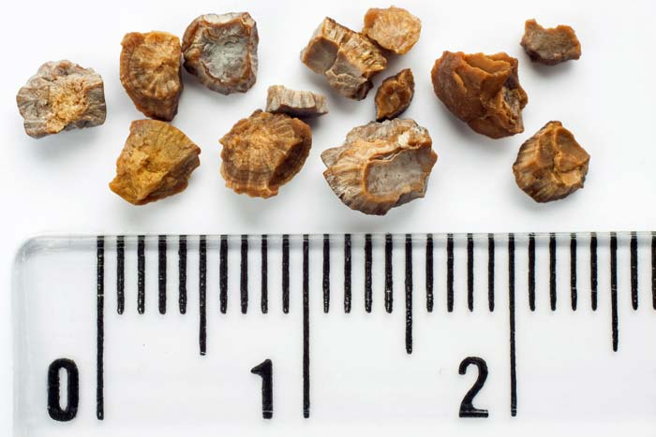
Disorders of the Urinary system
Pyelonephritis:
Infections of the kidney and curable with antibiotics
Kidney stones:
Hard granules composed of uric acid, calcium or protein that form in the renal pelvis.
It is caused by too much protein consumption, pH imbalance or urinary tract infection.
Notes:
Passing a stone can be very painful.
Large kidney stones can destroy the nephrons
Signs of kidney damage is the presence of albumin, WBC or RBC in urine. Urea can accumulate in blood called uremia. Retention of water and salts can cause damage called edema

Slide 22
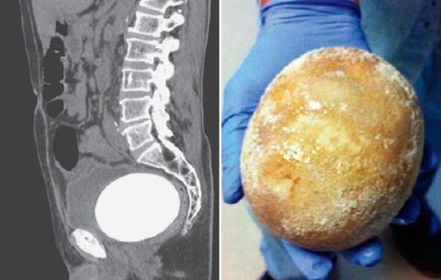
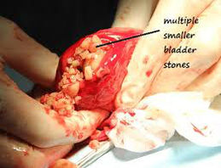
Cystitis:
inflammation of the bladder can result in urethritis (urethra infection)
Almost all urinary infections can be cured with antibiotics
Bladder stones:
Usually occur due to other conditions that interfere with urine flow ie prostate enlargement
Bladder cancer is the fourth most common type in men in Canada.
Notes:
Woman more prone to urinary infections due to short urethra
Stones make is difficult to urinate.

